Slide 1


SHRI.C.J.PATEL COLLEGE OF COMPUTER STUDIES,VISNAGAR
Project Title :- SEASONAL SHOP
Years:-2022-2023
Group no:-8
SNO | GROUP MEMBER NAME | ROLL NO | P.R.NO
1) | PATEL SETU JITENDRABHAI | 52 | 2020095900000693
2) | PATEL YASH AMRUTBHAI | 59 | 2020095900000975
3) | MAKVANA RAJ DIPAKKUMAR | 17 | 2020095900000445

Slide 2
Introduction of Project
Our project titled “Seasonal shop” is an online shopping product for particular season. It delivers User to registration to this site and search and buy product.
in this site product cell to particular season wise. It providing good product delivery services to third company.
The main intention of the project is to cell product to season wise.

Slide 3
Drawback of Existing System
You can`t compare prices with other stores
Choices are very less in offline Shopping
hard to find past records
It Consumes More Time
It is not provide Festival & Sale discounts
It is not active 24x7

Slide 4
Need for New System
We are easily find past recorded for specific analysis.
Choices are very expansive in online Shopping
It is not consume more time
It is provide Festival & Sale discounts
It is active 24x7.

Slide 5
Tools & Technology
Operating Systems
Window: 10
Acer: Microsoft Window
Software
Code Editor: VS code[version 1.77]
Browser: Google Chrome[version 22]
XAMPP [version 1.7.1 or higher]
Front-End Tool
HTML [version 5]
CSS [version 4.15]
JavaScript [version ES6]
Boot-Strap [version 5.0]
Back-End Tool
PHP [version 5.3 or higher]
Data Base
MySQL [client version 5.1.41 or higher]

Slide 6
Module
Customer
Show product
Registrations User
Add to cart
Login Users
Post orders
Give Product reviews
Give Feedback our website
Contacts
Admin
Login
Manage Product Stock
Manage Product for sale
Manage category / brands
Manage orders
Manage product reviews
Replay Questions
Make Report and Analysis
View Feedback

Slide 7
Context Level DFD
0.0
S2S (SEASON TO SEASON ONLINE SHOP)
Login/Registration
Login/Registration
Admin
User
Login/Registration
Login/Registration

Slide 8
First Level DFD

Slide 9
Login/Registration
1.0
Authentication
Check users info
Customer
USERS
Success/cancel
Message (success/cancel)
2.0
Add product to cart
Request to add product
Add To Cart
PRODUCTS
Message (success/cancel)
Success to Add Product
Message to post order
3.0
Post Orders
Post user order
USERS_ORDERS
Message to post orders
Message (success/cancel)
Request to cancel order
4.0
Cancel user order
Cancel
Orders
COMPLETE_ORDERS
Message (success/cancel)
Message to cancel Orders
Add questions
USER_QUEASTIONS
Ask questions
5.0
Questions/Like
Message (success/cancel)
List to questions
LIKE_TABLE
Give to Answers
Message(success/cancel)
Give Reviews
6.0
Add review
Reviews/Feedback
Message(success/cancel)
USER_REVIEW
Add feedback
USER_FEEDBACK
Message to add Reviews
Message (success/cancel)
Page 9 of 34

Slide 10
First Level DFD(Admin)

Slide 11
Login/Registration
1.0
Authentication
Check Admin info
Admin
ADMIN_TABLE
Success/cancel
Message (success/cancel)
2.0
Store product stock
Insert product stocks
Insert product stock
PRODUCTS_STOCK
Message (success/cancel)
Success to add product stock
Insert products to sale
3.0
Insert product to sale
Store product
PRODUCTS
Message to add products
Message (success/cancel)
Store category
CATEGORIES
Insert brand and category
4.0
Insert brand/category
Message(success/cancel)
Store Brand
BRAND
Message to add
Message(success/cancel)
Update products
PRODUCTS
Update product and brand
5.0
Updates
Message (success/cancel)
Update brand
BRAND
Message to update
Message(success/cancel)
Delete brand and category
6.0
Delete category
Delete
Message(success/cancel)
CATEGORY
Delete Product
Message to delete
PRODUCTS
Message (success/cancel)
Page 11 of 34

Slide 12
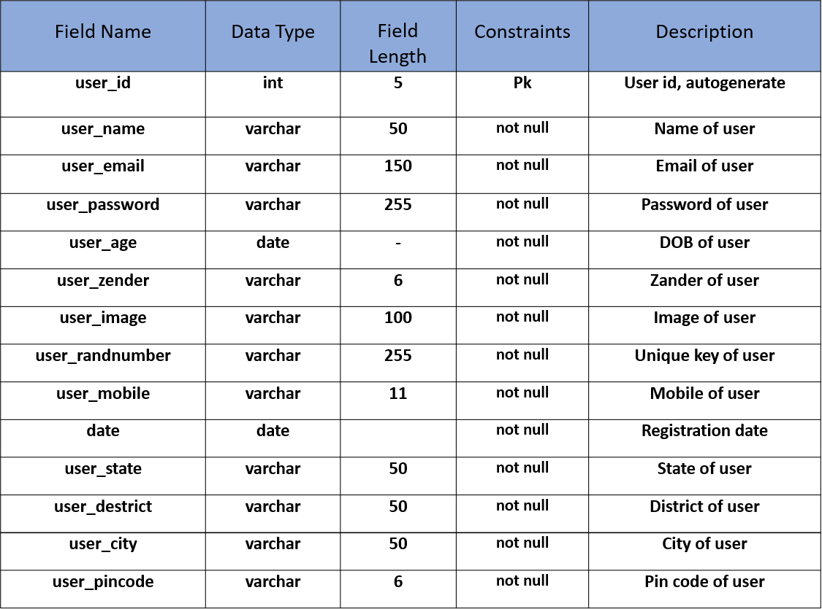
Data Dictionary 1. user_table

Slide 13
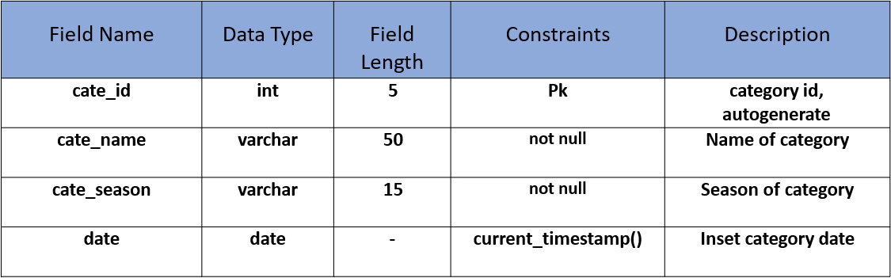
2 categories

Slide 14
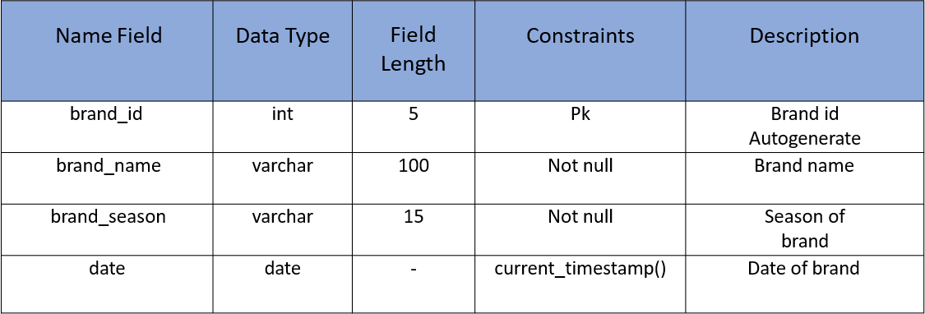
3. brands

Slide 15
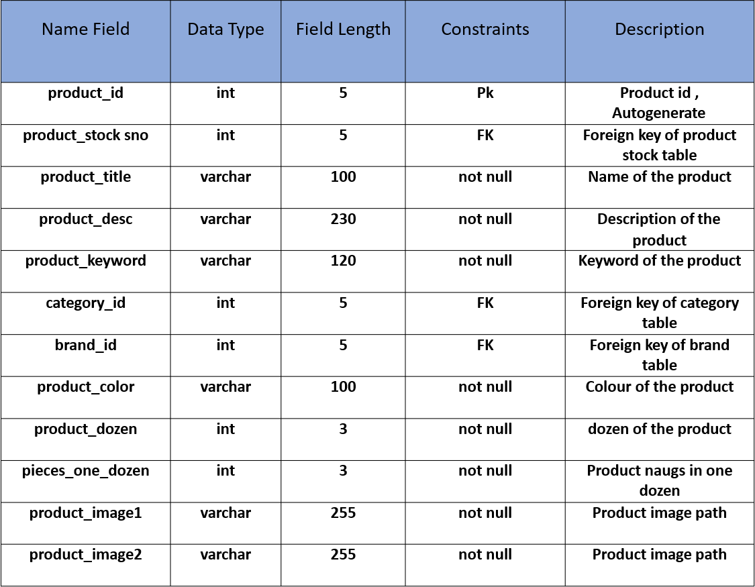
4. product

Slide 16
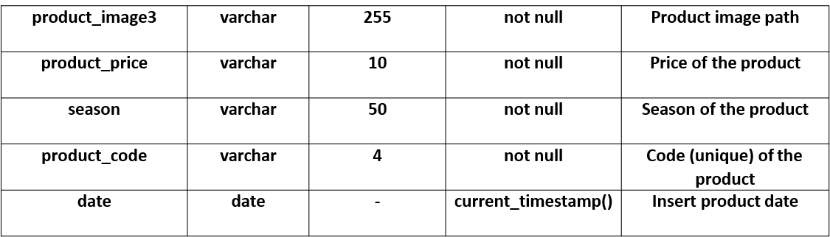
SHRI C. J. PATEL COLLAGE OF COMPUTER STUDIES, VISNAGAR
5. products_stock
S2Sshop (Season to Season online Shop)
Page 16 of 34

Slide 17
Name Field | Data Type | Field Length | Constraints | Description
product_stock_sno | int | 5 | Pk | Product stock id, Autogenerate
product_name | varchar | 200 | not null | Name of product
product_brand | varchar | 100 | not null | Brand of product
product_color | varchar | 200 | not null | Colour of product
product_season | varchar | 10 | not null | Season of product
product_code | varchar | 4 | not null | Code(unique) of product
total_product_dozen | int | 5 | not null | Total product dozen for buy
pieces_one_dozen | int | 3 | not null | Product nug in one dozen
total_stock_cost | int | 9 | not null | total stock for product stock buy
stock_date | datetime | -- | current_timestamp() | Inset product stock date

Slide 18
6. products_saleing_price
FIELD NAME | DATA TYPE | FIELD LENGHT | CONSTRAINTS | DESCRIPTION
produtc_selling_price_id | Int | 5 | PK | Product selling price id, Autogenerate
product_stocks_no | int | 5 | FK | Foreign key of product Stock table
product_code | varchar | 4 | not null | Unique code of product
packing_cost | varchar | 3 | not null | Packing cost of product
dilevery_cost | varchar | 3 | not null | Cost of product delivery
profit_margin | varchar | 3 | not null | Profit of sell product
other_cost | varchar | 3 | not null | Sell Other cost of product
selling_product_price | varchar | 7 | not null | Calculate selling price of product
date | date | - | current_timestemp() | Insert(sell)product date

Slide 19
7. user_orders
FIELD NAME | DATA TYPE | FIELD LENGHT | CONSTRAINTS | DESCRIPTION
order_id | int | 5 | PK | Order id/Auto generates
product_name | varchar | 200 | not null | name of product
brand_name | varchar | 100 | not null | Brand name of product
product_color | varchar | 200 | not null | Color of product
cell_product_dozen | int | 6 | not null | Dozens of product
one_dozen_product_price | int | 5 | not null | Product price nug of one dozen
total_dozen_product_price | int | 5 | not null | Total product dozen price
product_ pieces_one_dozen | int | 5 | not null | Product nug one dozen
order_address | varchar | 255 | not null | Address of user order

Slide 20
order_pincode | varchar | 7 | not null | Pin code of user order
order_number | varchar | 30 | not null | Order number
randip | varchar | 355 | not null | id address of user system
ip_address | varchar | 255 | not null | User ip address
pyment_method | varchar | 150 | not null | Payment method
pay_amount | int | 5 | not null | Pay amount of user order
order_status | varchar | 30 | not null | Status(complete/incomplete)
product_code | varchar | 4 | not null | Unique code of product
product_image | varchar | 200 | not null | Path of image
profit_margin | int | 5 | not null | Profit margin of product
date | Datetime | - | not null | User order date

Slide 21
7. complete_order
FIELD NAME | DATA TYPE | FIELD LENGHT | CONSTRAINTS | DESCRIPTION
comord_id | int | 5 | PK | Complete order id,Auto generate
order_id | int | 11 | FK | Order id of orders table
order_number | varchar | 50 | not null | Order number(unique)
orders_days | int | 5 | not null | Days of complete order
delivery_product_status | varchar | 50 | not null | Status(complete/incomplete) Of order
date | datetime | - | current_timestemp() | Date of order complete
delivery_last_date | date | - | current_timestemp() | Last date of product delivery

Slide 22
8. complete_payment_order
FIELD NAME | DATA TYPE | FIELD LENGTH | CONSTRAINTS | DESCRIPTION
com_payment_id | int | 5 | PK | Complete payment id, autogenerate
order_id | int | 5 | FK | Foreign key of user order table
comrd_id | int | 5 | FK | Foreign key of complete payment order table
order_number | varchar | 15 | not null | Order number
pay_amount | varchar | 8 | not null | Payment of orders
date | date | - | current_timestemp() | Payment order date

Slide 23
9. user_questions
FIELD NAME | DATA TYPE | FIELD LENGTH | CONSTRAINTS | DESCRIPTION
que_id | int | 5 | PK | Questions id,Auto generate
product_id | int | 11 | FK | Foreign key of Product
district_name | varchar | 100 | not null | District name
district_code | int | 10 | not null | Code of district
state_id | int | 10 | FK | Foreign key of state table

Slide 24
10. like_table
FIELD NAME | DATA TYPE | FIELD LENGTH | CONSTRAINTS | DESCRIPTION
like_id | int | 5 | PK | Like id, Auto generate
product_id | int | 11 | FK | foreign key of product table
user_id | int | 11 | FK | foreign key of user table
questions_id | int | 11 | FK | foreign key of user questions table
liketype | varchar | 100 | not null | Type of like(like/dislike)
date | datetime | - | current_timestemp () | Time of like questions date

Slide 25
11. cart
FIELD NAME | DATA TYPE | FIELD LENGHT | CONSTRAINTS | DESCRIPTION
cart_id | int | 5 | PK | Cart id,Auto generate
product_id | int | 5 | FK | Foreign key of product table
user_id | int | 5 | FK | Foreign key of user table
rand_ip | varchar | 255 | not null | Rand ip of user
quntity | int | 5 | not null | Quantity of product
product_dozen | int | 3 | not null | Product dozen for product add cart
product_price | varchar | 7 | not null | Price of product
cart_date | datetime | - | current_timestemp() | Insert product in cart

Slide 26
12. user_review
FIELD NAME | DATA TYPE | FIELD LENGHT | CONSTRAINTS | DESCRIPTION
rew_id | int | 5 | PK | Review id, Auto generate
order_id | int | 5 | FK | Foreign key of user order table
rew_about_product | varchar | 255 | not null | Review about product by user
rew_star | int | 1 | not null | star rating by user
rew_image | varchar | 255 | not null | Image of user product
product_code | varchar | 4 | not null | Product code
order_number | varchar | 30 | not null | Order number of user
rew_status | varchar | 10 | not null | Add review or volt in product section
rew_date | date | - | current_timestemp() | Date of used review

Slide 27
13. user_feedback
FIELD NAME | DATA TYPE | FIELD LENGHT | CONSTRAINTS | DESCRIPTION
fb_id | int | 5 | PK | Feedback id,Auto generate
randip | varchar | 255 | Not null | Rand ip of user
feedback | varchar | 255 | Not null | Feedback of user
date | date | - | current_timestemp() | Date for user feedback

Slide 28
14. admin_table
FIELD NAME | DATA TYPE | FIELD LENGHT | CONSTRAINTS | DESCRIPTION
admin_id | Int | 2 | PK | Admin id, Autogenerate
admin_email | varchar | 255 | not null | Email of admin
admin_username | varchar | 15 | not null | Name of admin
admin_password | varchar | 15 | not null | Password admin
admin_mno | varchar | 10 | not null | Number of admin
admin_status | varchar | 11 | not null | Status(active/inactive)
admin_date | datetime | - | current_timestemp() | Date of admin insert

Slide 29
15. Contacts
FIELD NAME | DATA TYPE | FIELD LENGHT | CONSTRAINTS | DESCRIPTION
conus_id | int | 5 | PK | contact id, Autogenerate
conus_email | varchar | 200 | not null | Email of contact
conus_mobile | varchar | 11 | not null | Mobile of contact
conus_message | varchar | 300 | not null | Message of user
conus_date | date | - | current_timestemp() | Date of contact

Slide 30
ER-diagram

Slide 31
id
Address
Password
Process
Process
Email
Customer
LOGIN
Admin
Email
Password
Add to cart
Post Orders
Order number
Add
Cancel Orders
Address
name
season
id
Product
id
Product code
User Orders
Category
Cart
Accouter
name
Request
Products
color
quantity
Payment
Product code
Payment
brand
category
quantity
Product
Deliver product
Product Deliver Company
Supply
Product Stock
Order
Peking

Slide 32
HR-diagram
S2SShop
Admin
customer
Login
View product
Manage product
Login
Add to cart
Manage orders
Place orders
User profile
Manage cat/brand
Edite Profile
Manage question/review
Cancel Order
Give Review
Logout
Contact Us
Log Out

Slide 33
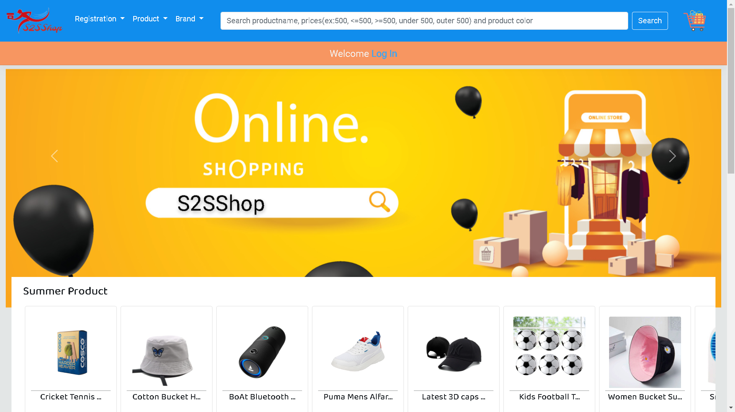
Bibliography
> Customer Side :- 1. Home Page

Slide 34
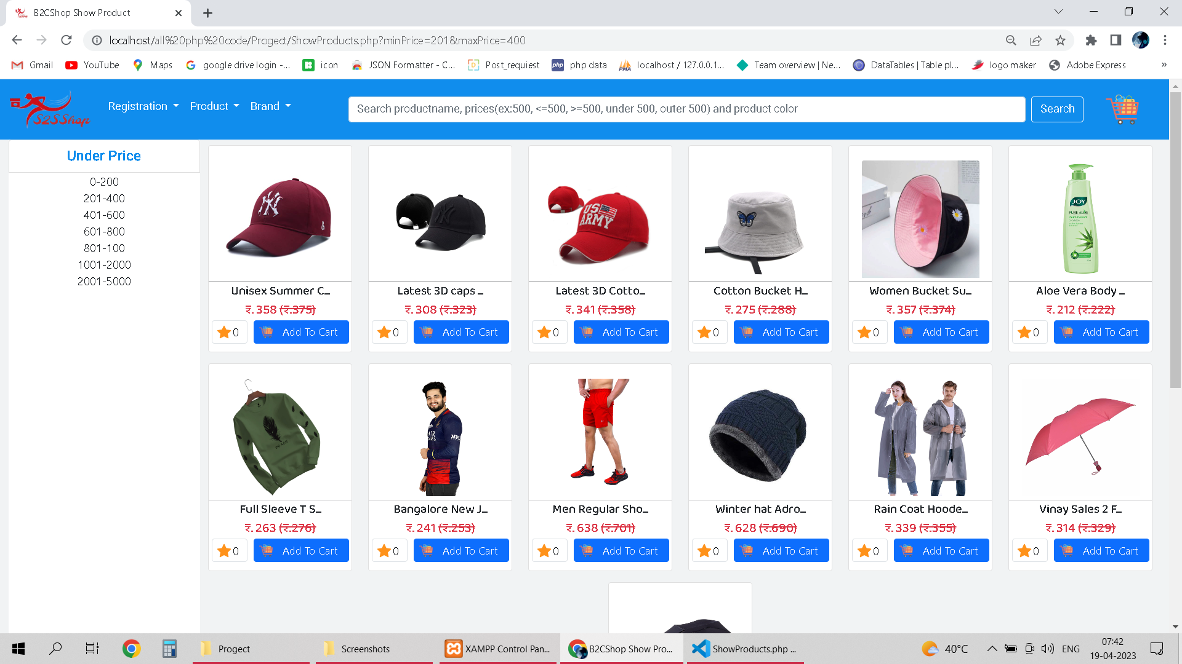
2. Show product page

Slide 35
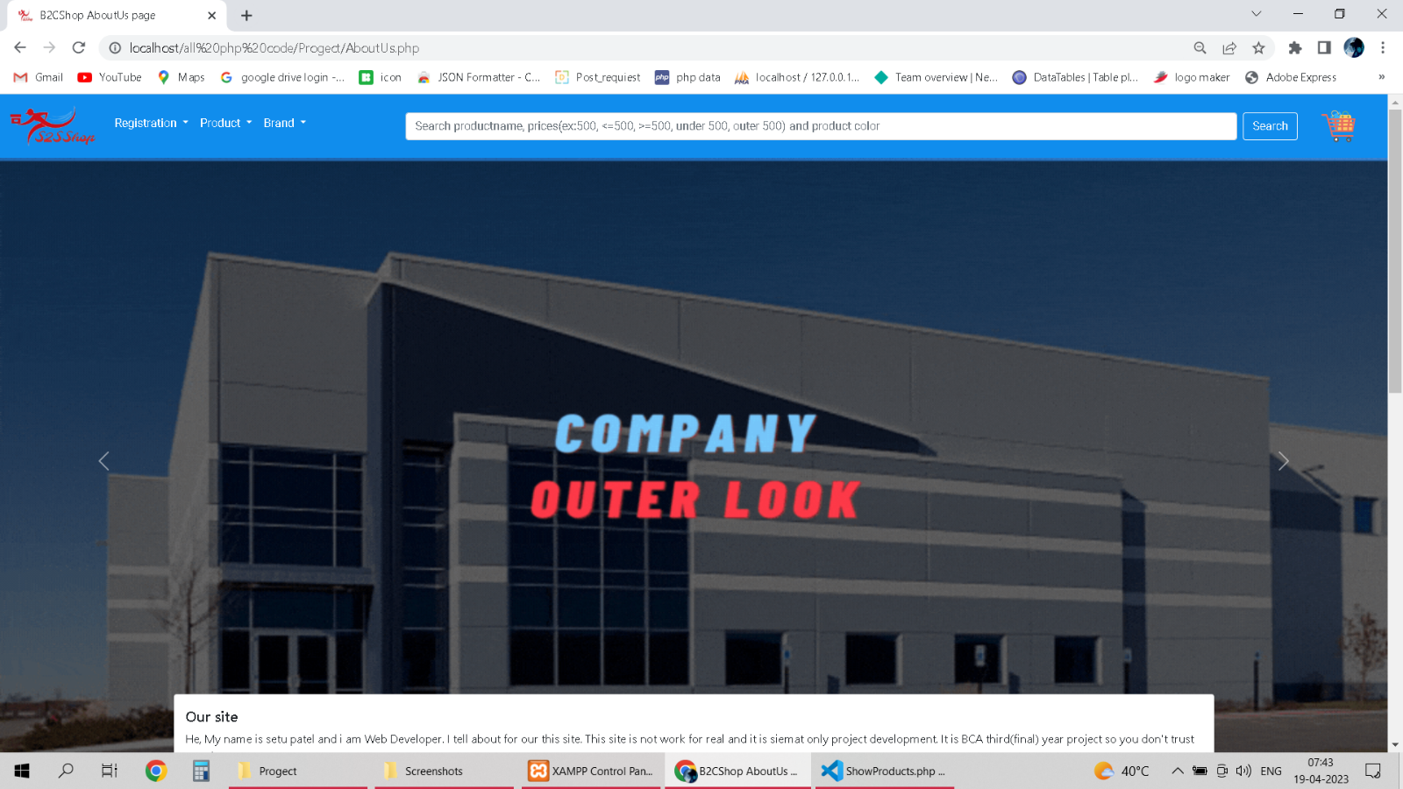
3. About Us page

Slide 36
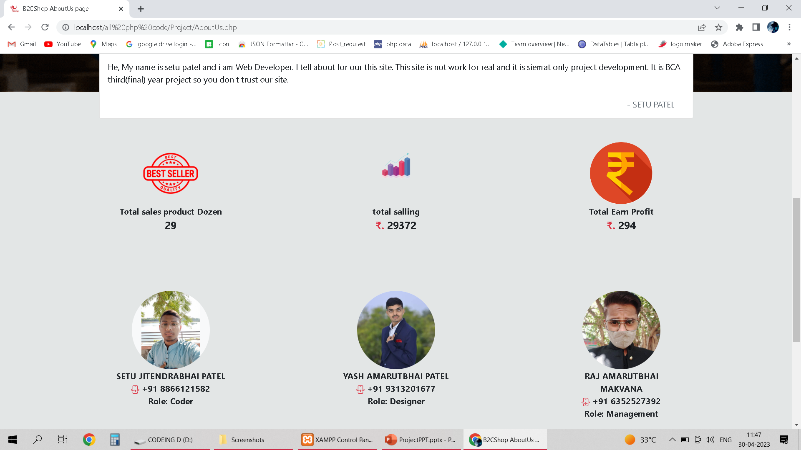

Slide 37
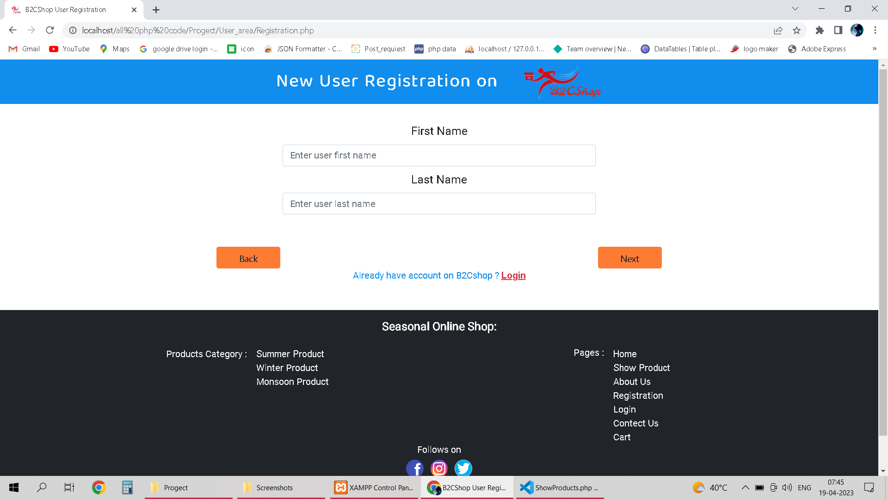
4. Registration page

Slide 38
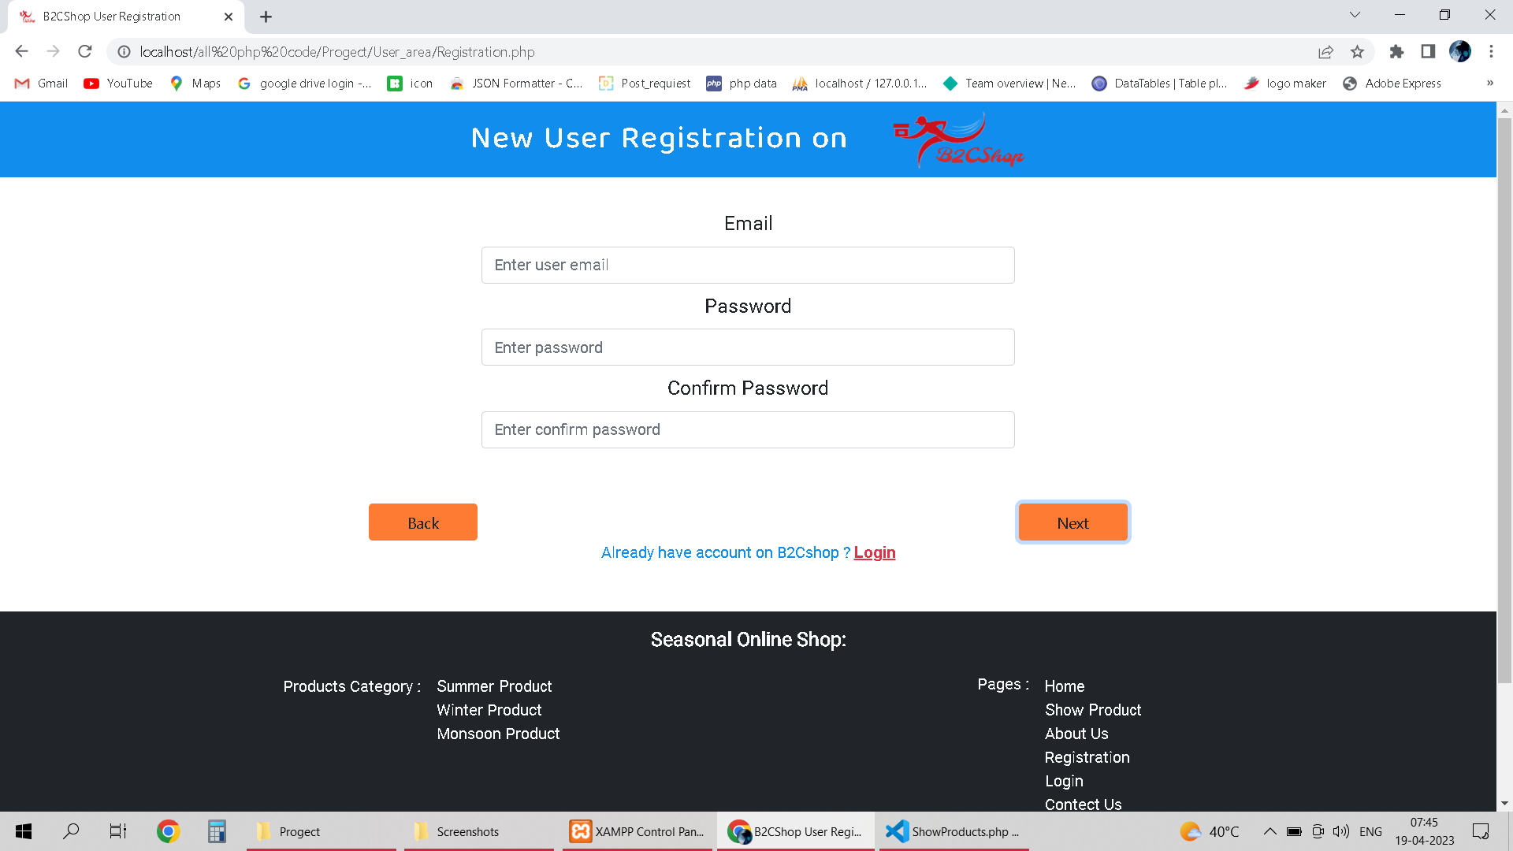
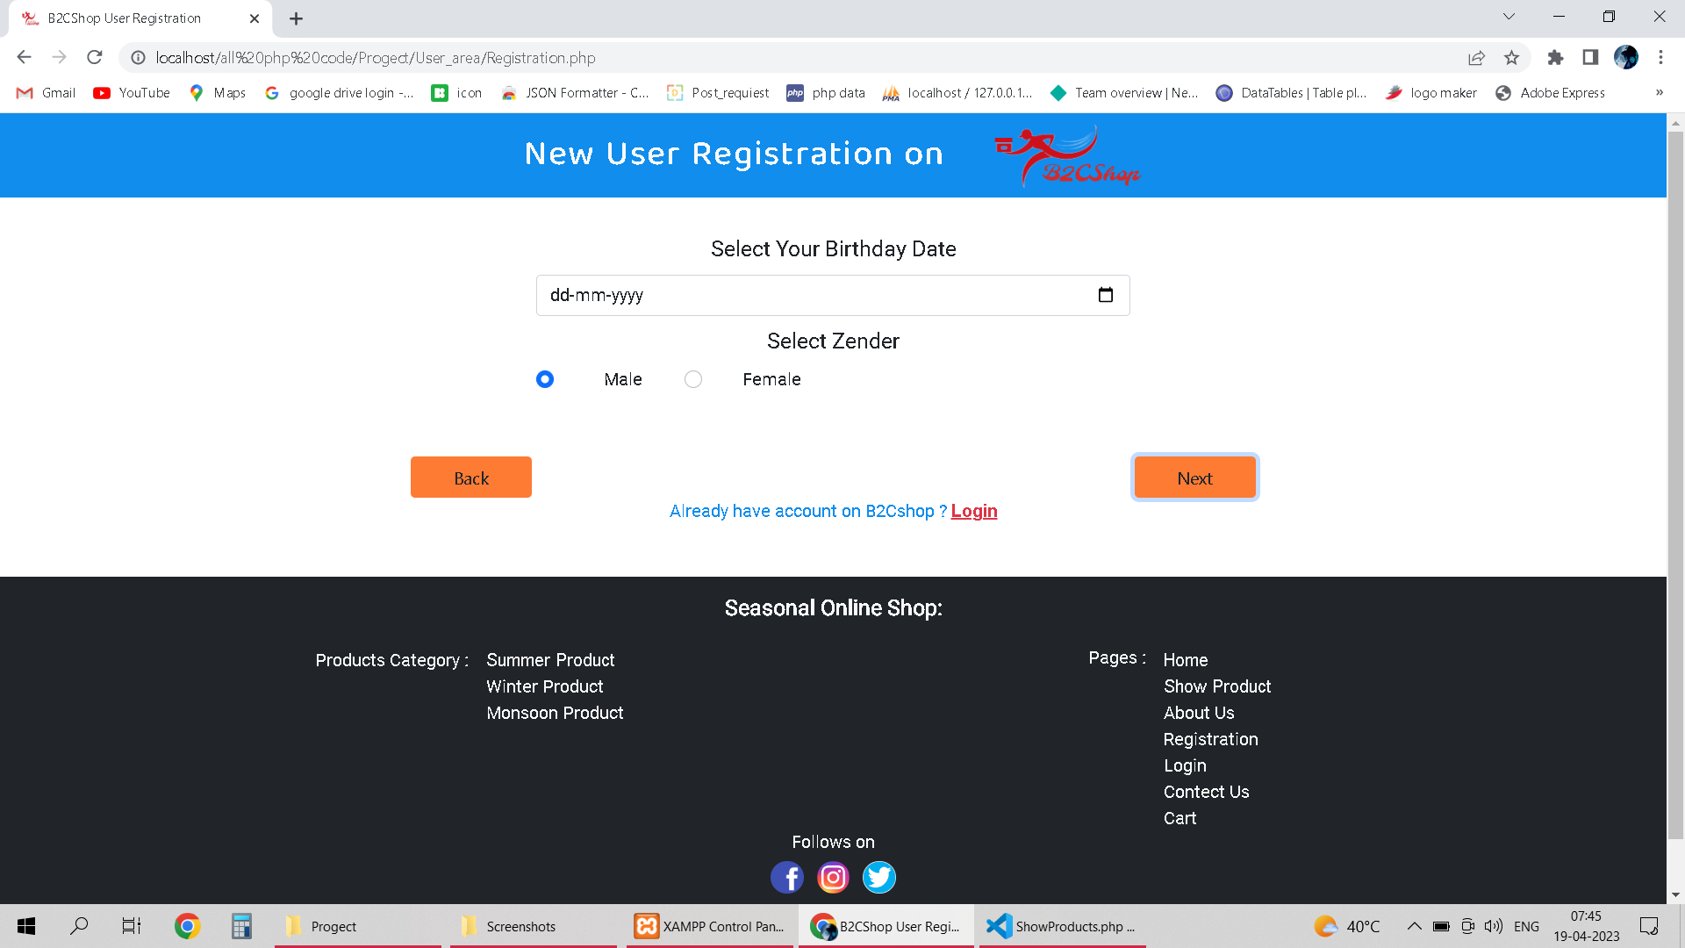

Slide 39
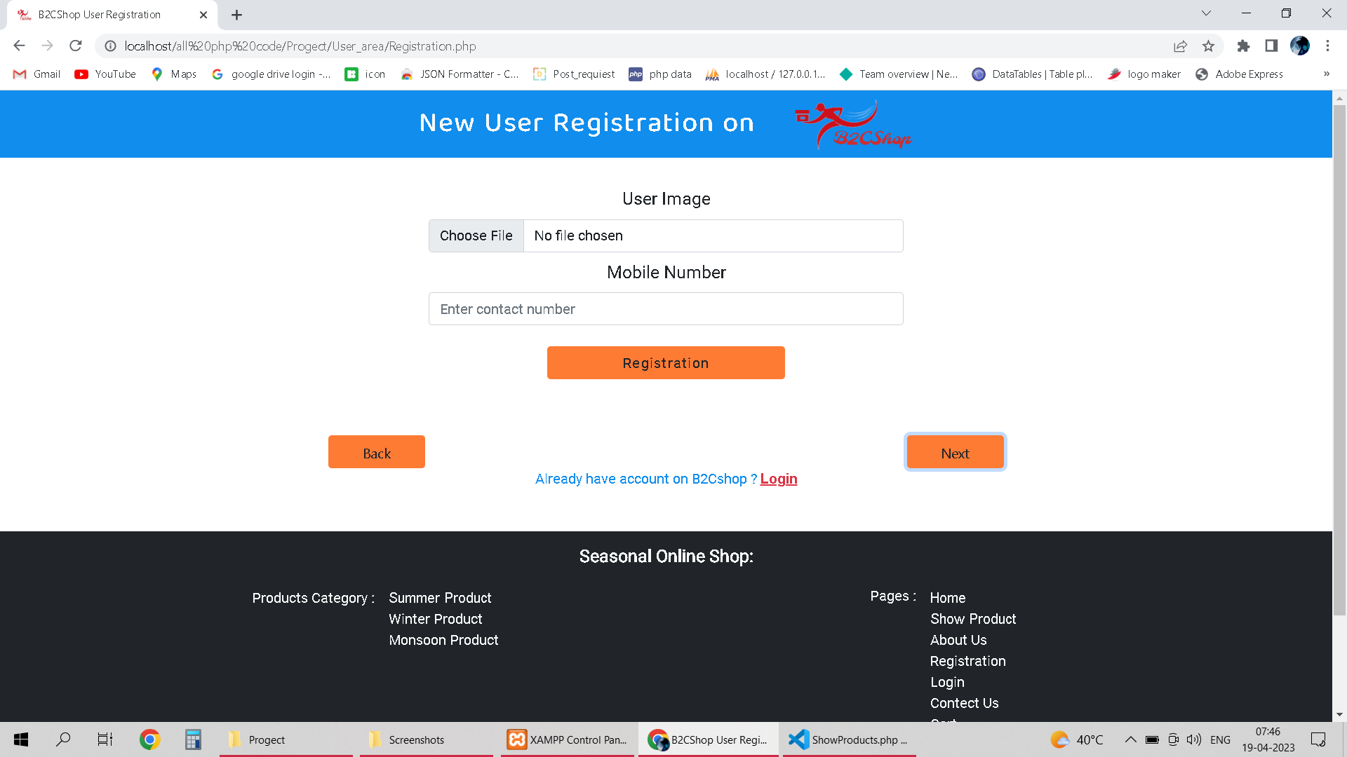

Slide 40
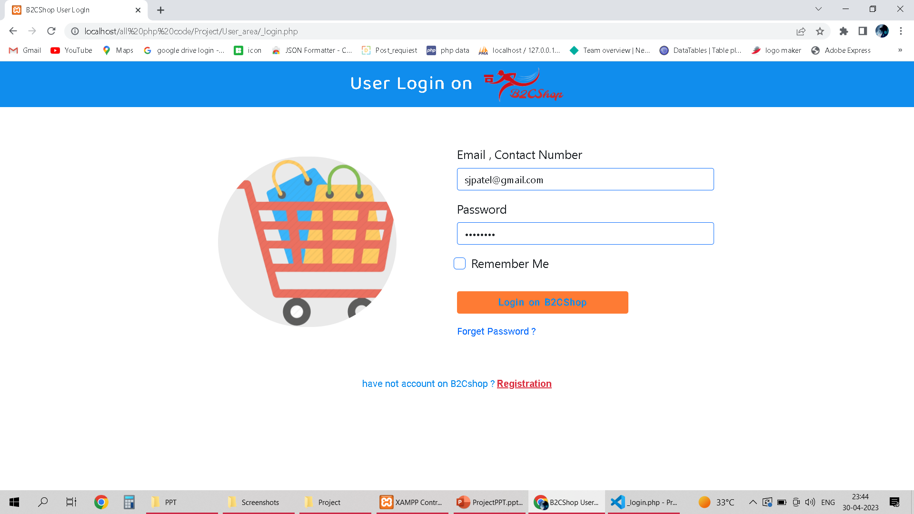
5. Login page

Slide 41
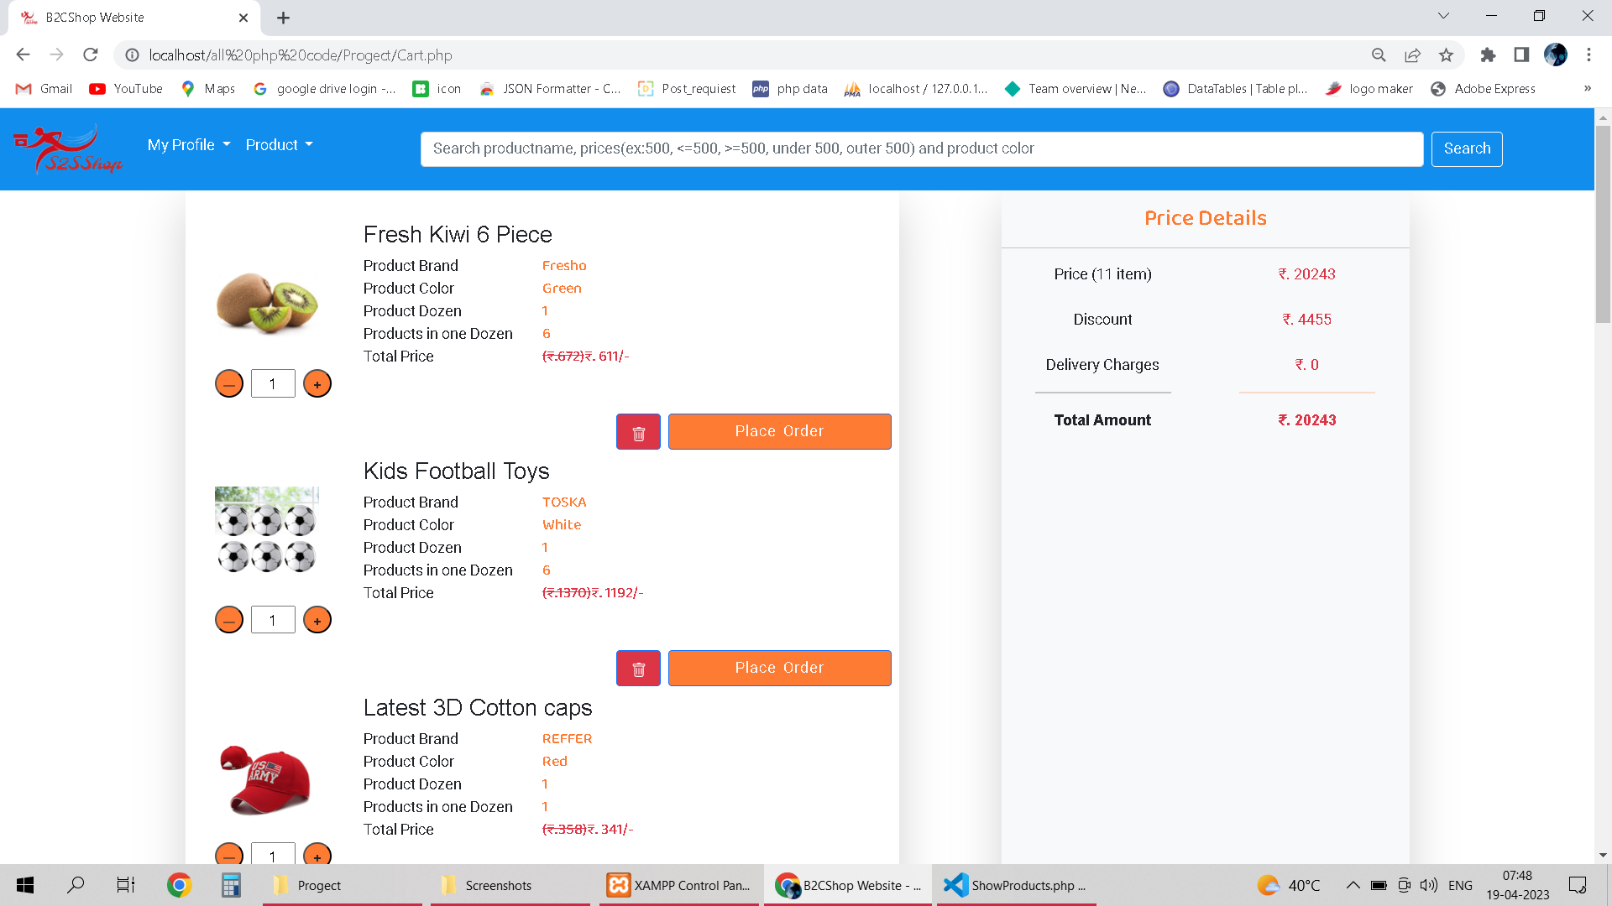
6. Cart page

Slide 42
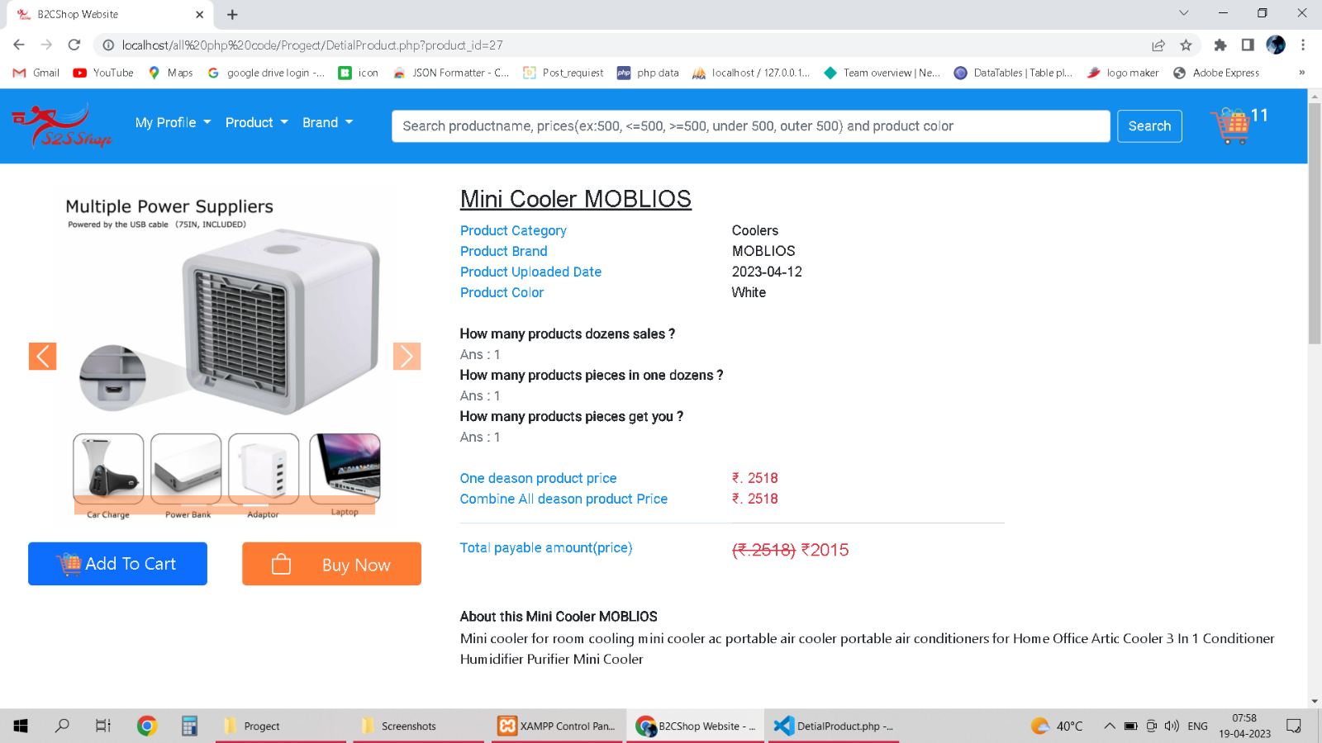
7. Product Details page

Slide 43
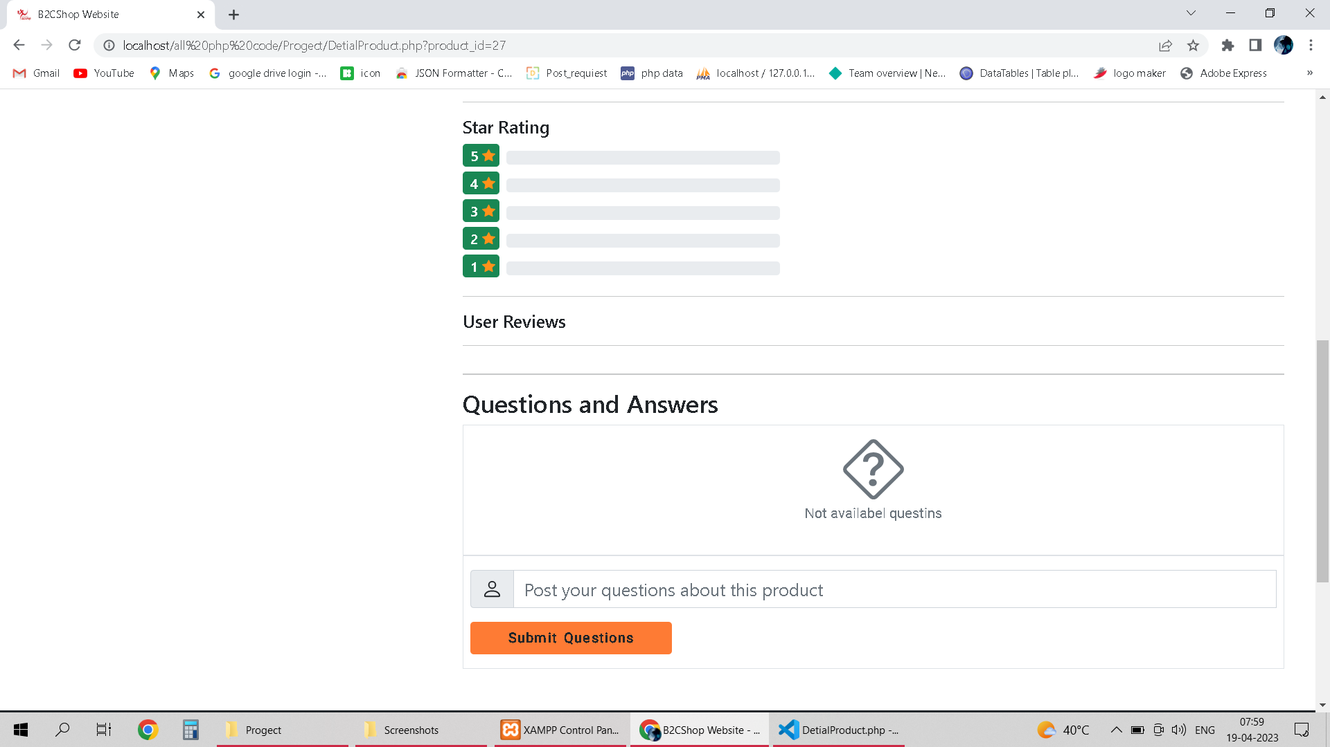

Slide 44
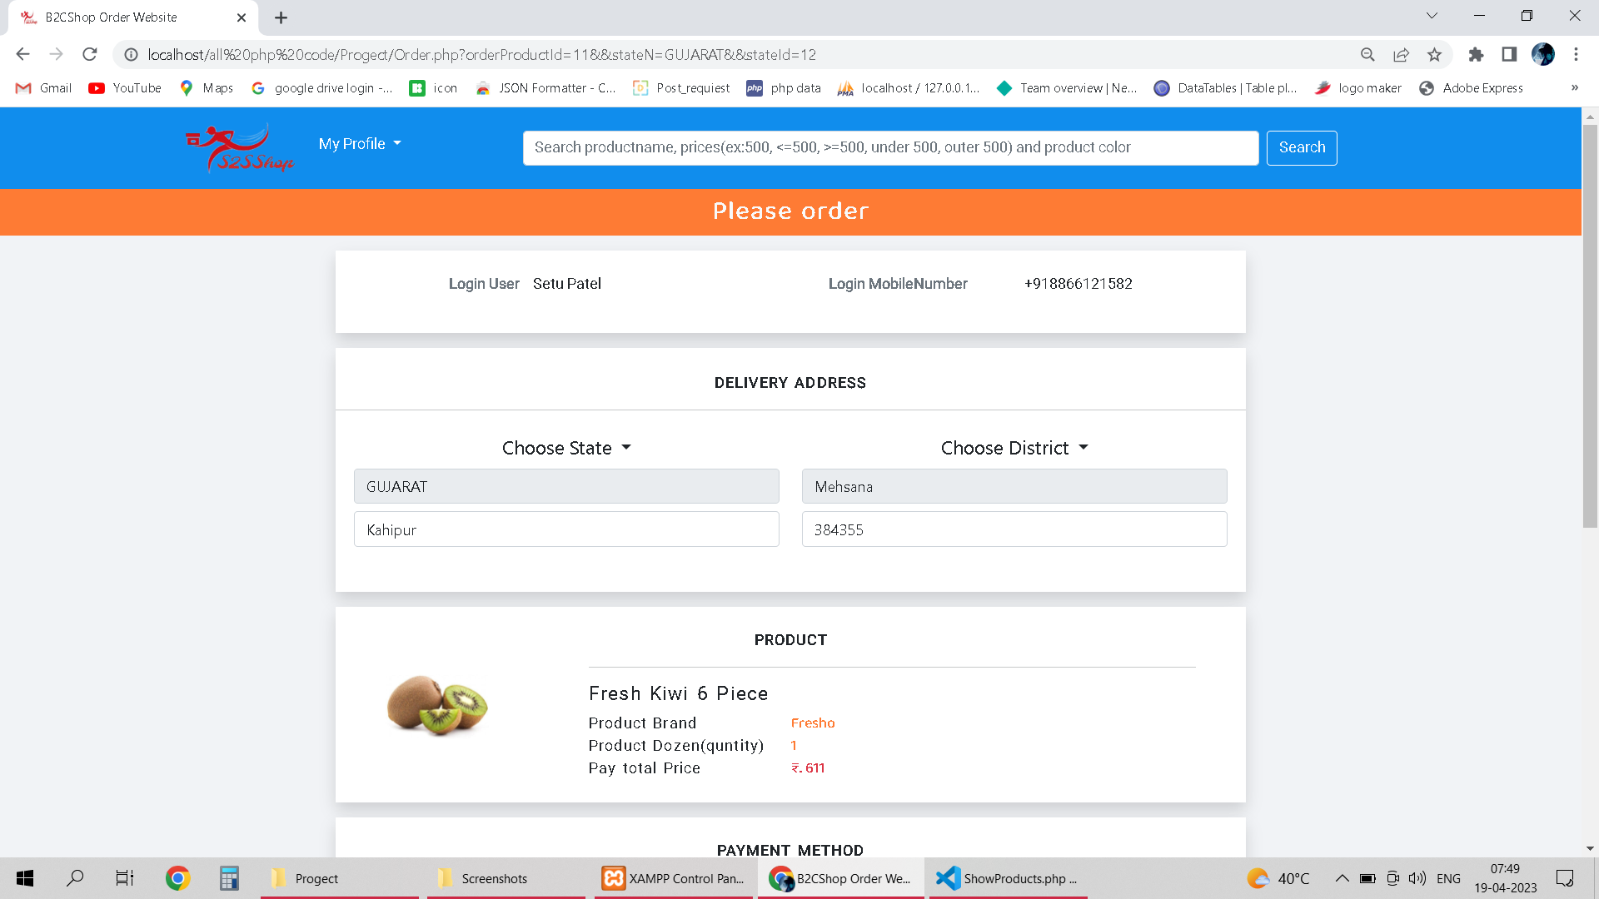
8. Post product orders page

Slide 45
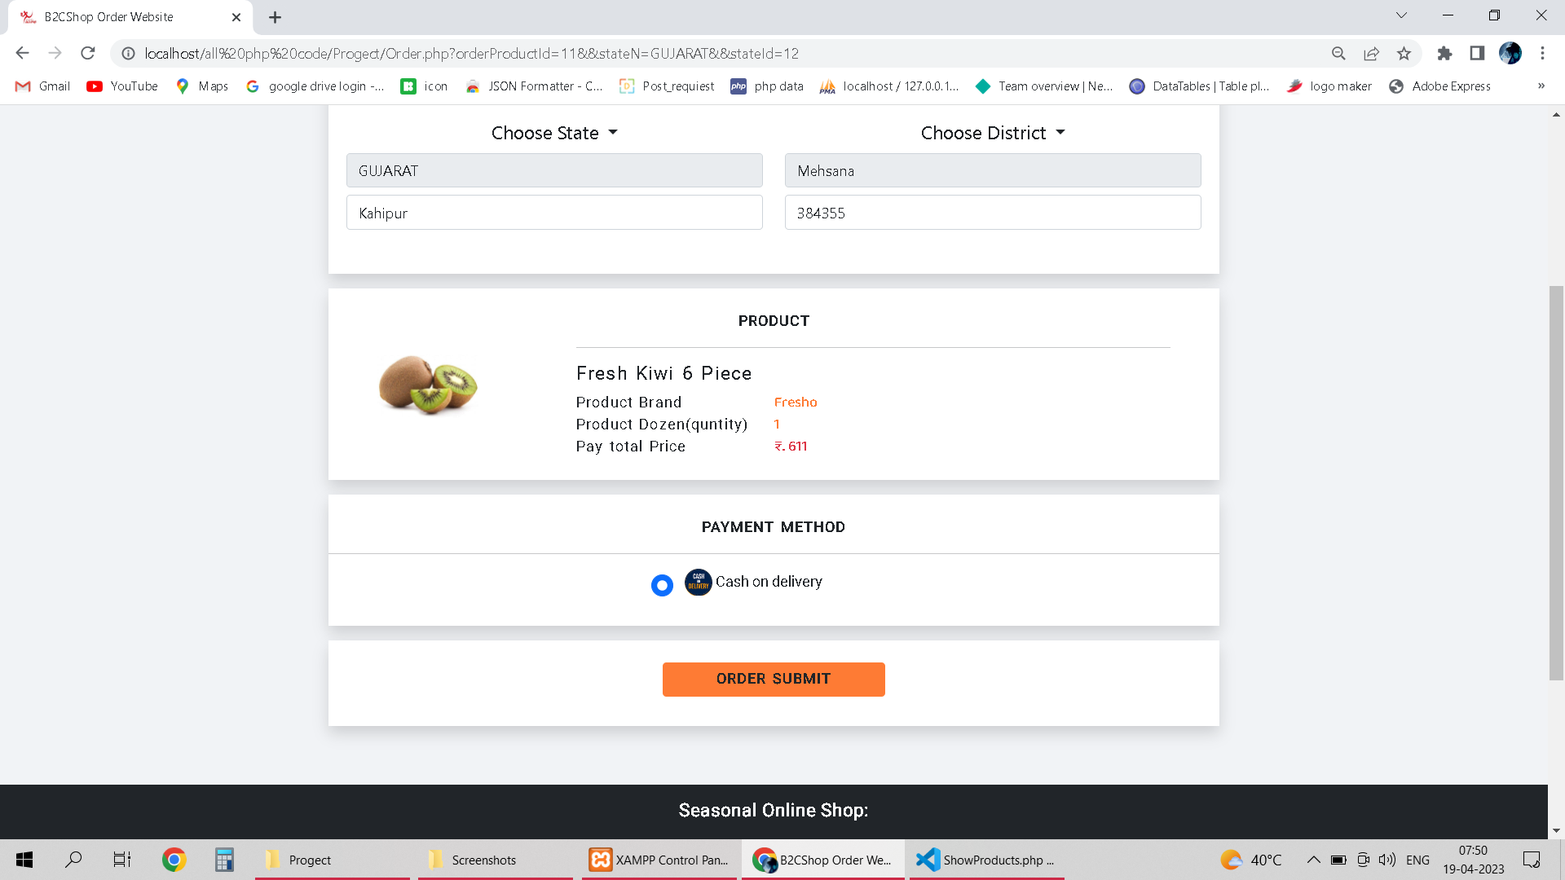

Slide 46
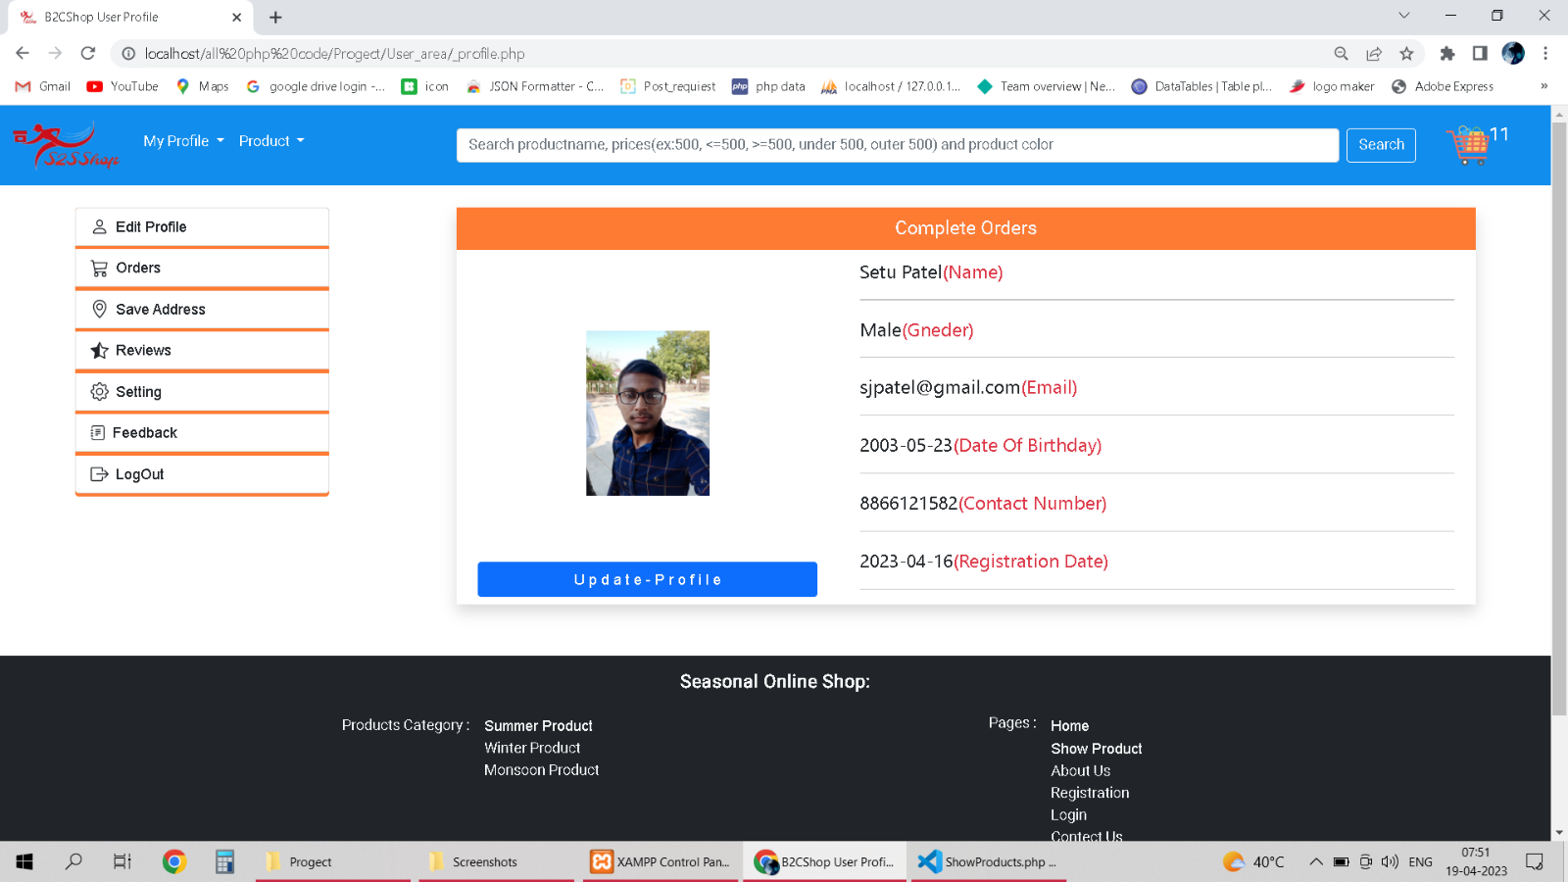
8. Profile page
I. User Profile Page

Slide 47
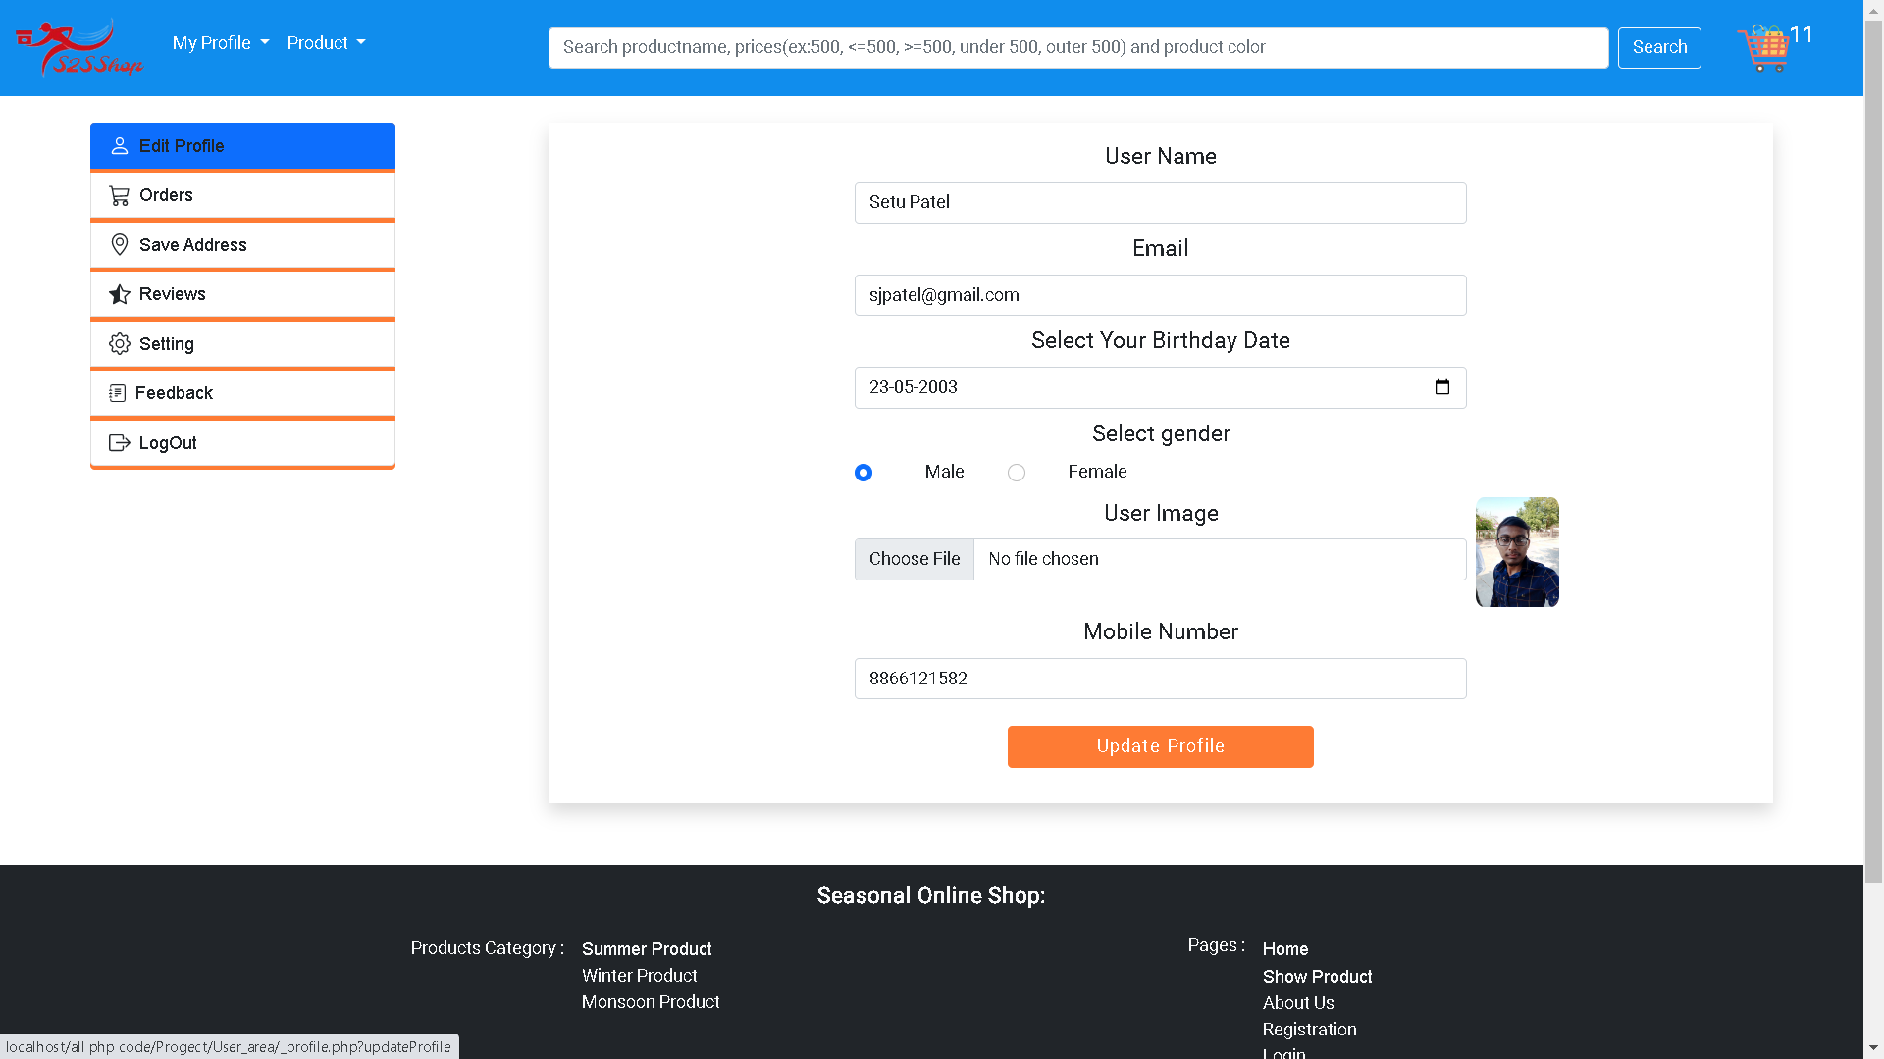
8. Profile page II. Edite Profile Page

Slide 48
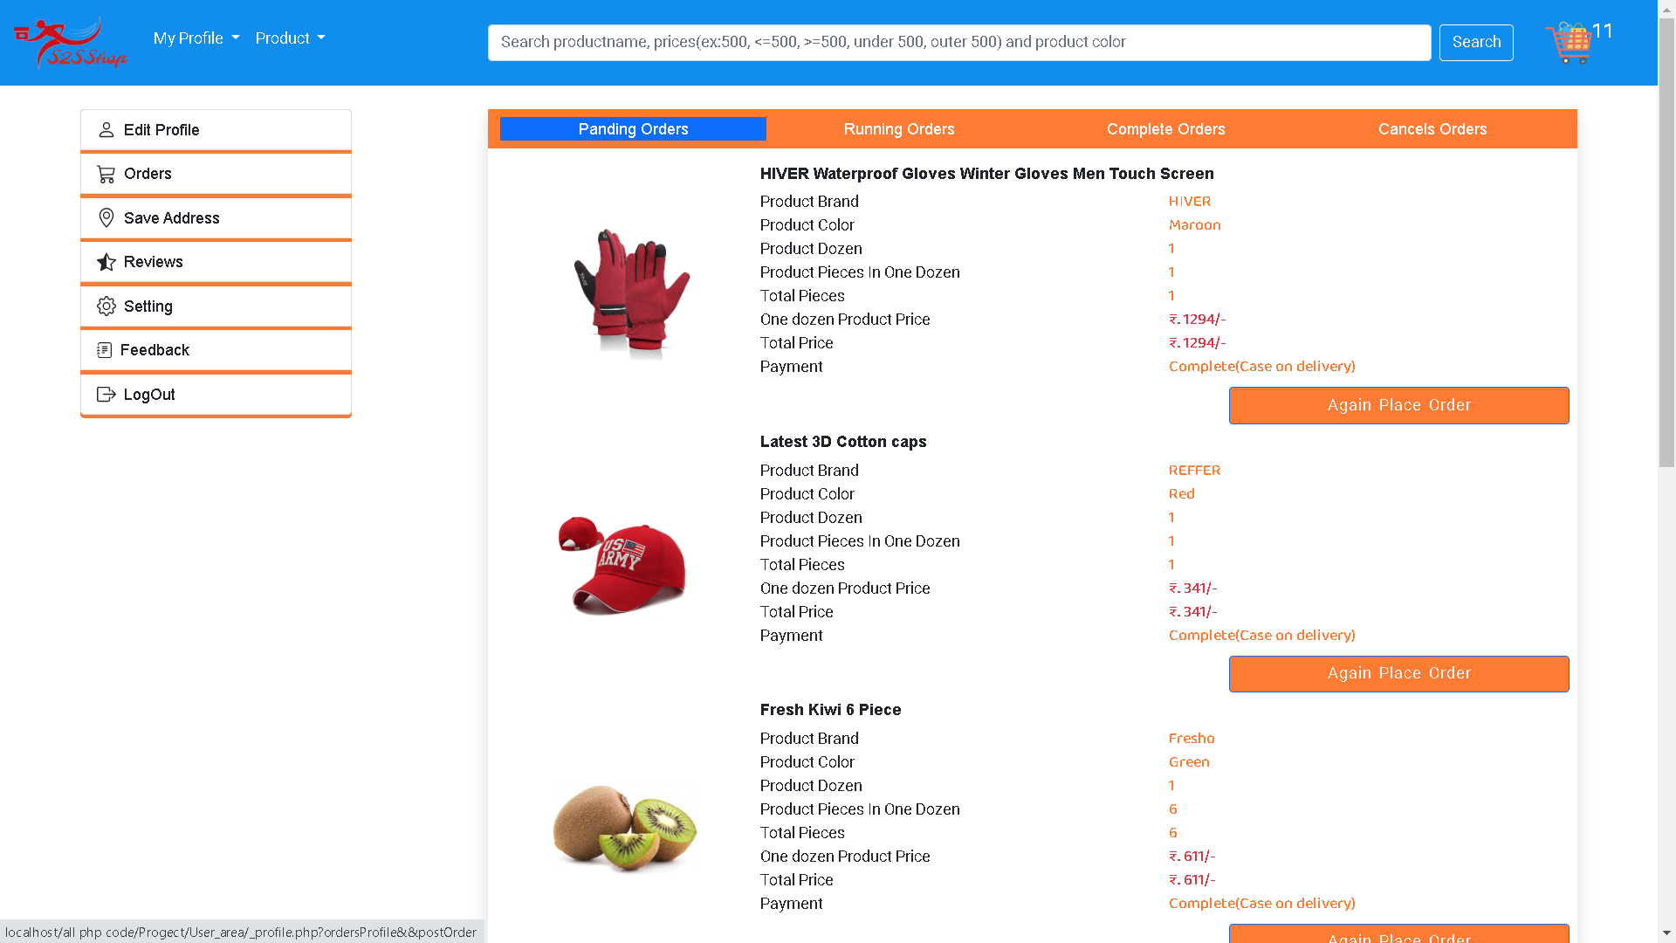
8. Profile page III. Orders(Pending, running, Complete, Cancel) Page

Slide 49
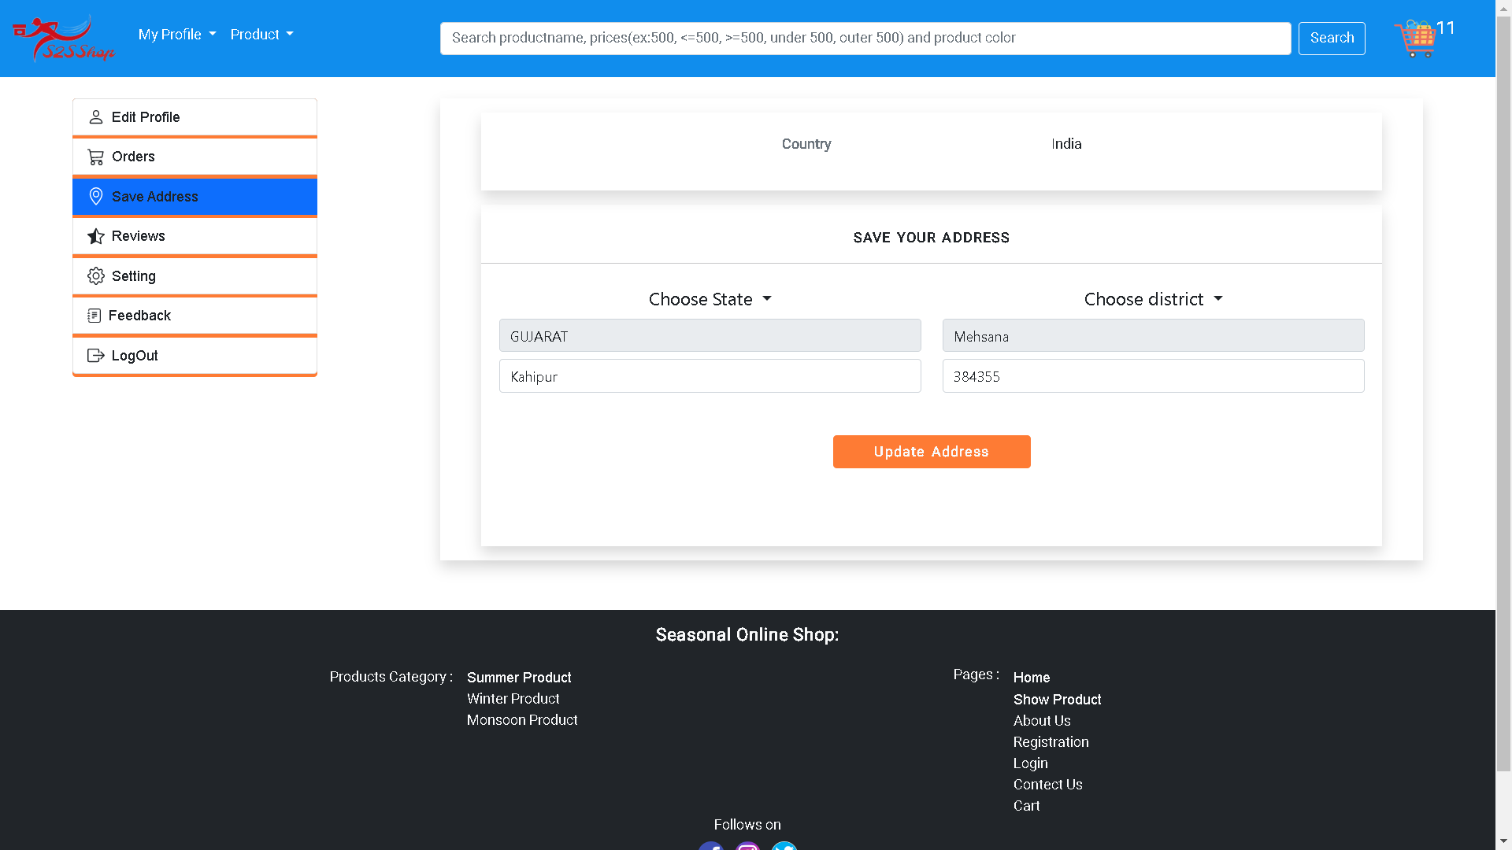
8. Profile page IV. Save Address Page

Slide 50
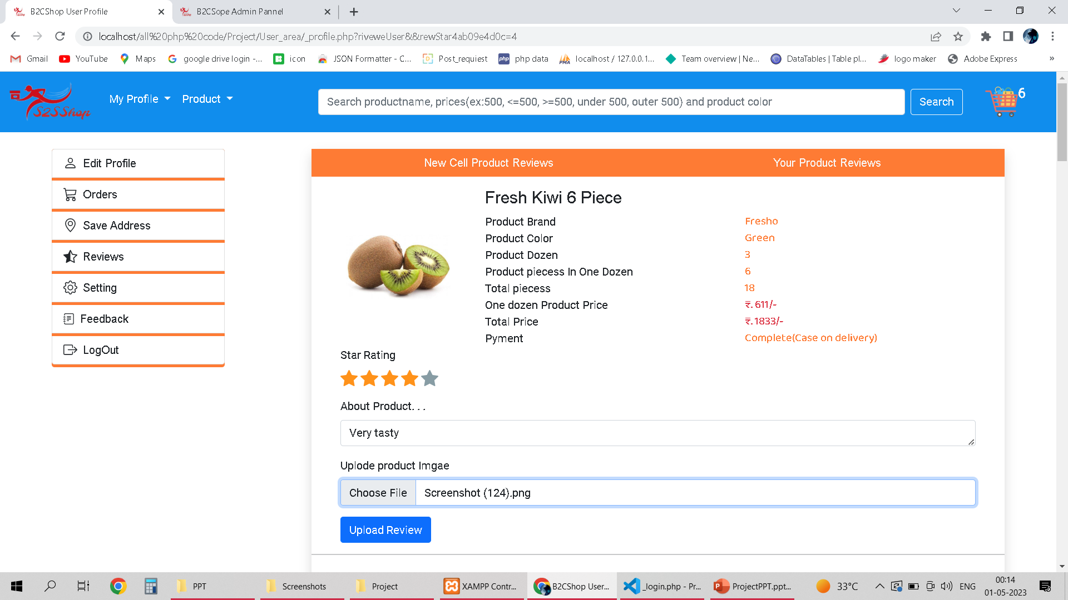
8. Profile page IV. Reviews Page

Slide 51
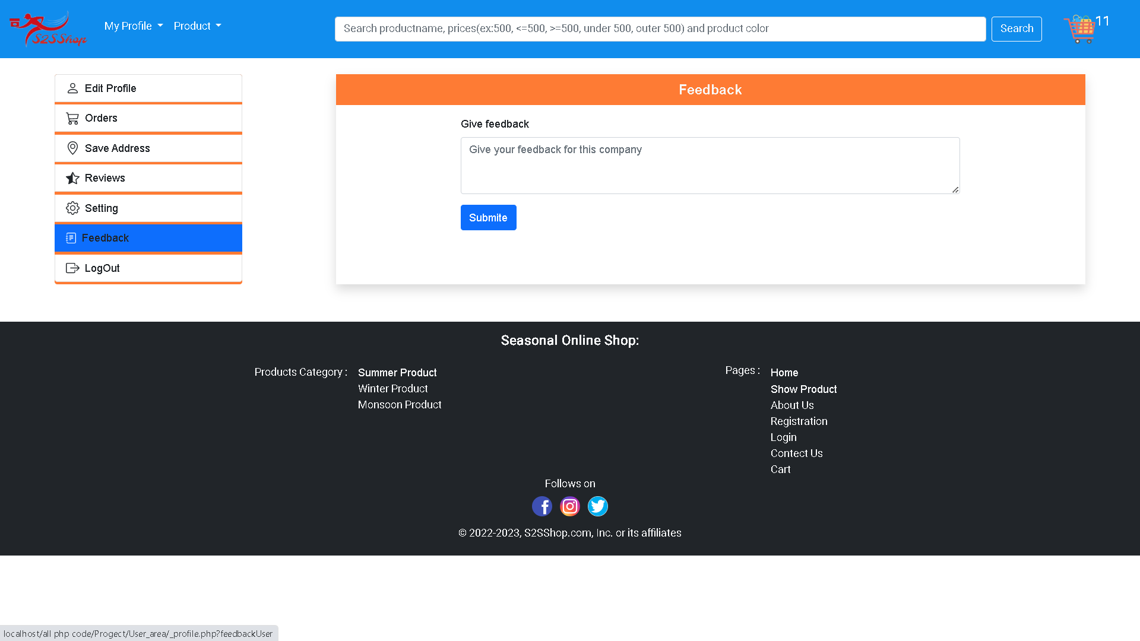
8. Profile page VI. Feedback Page

Slide 52
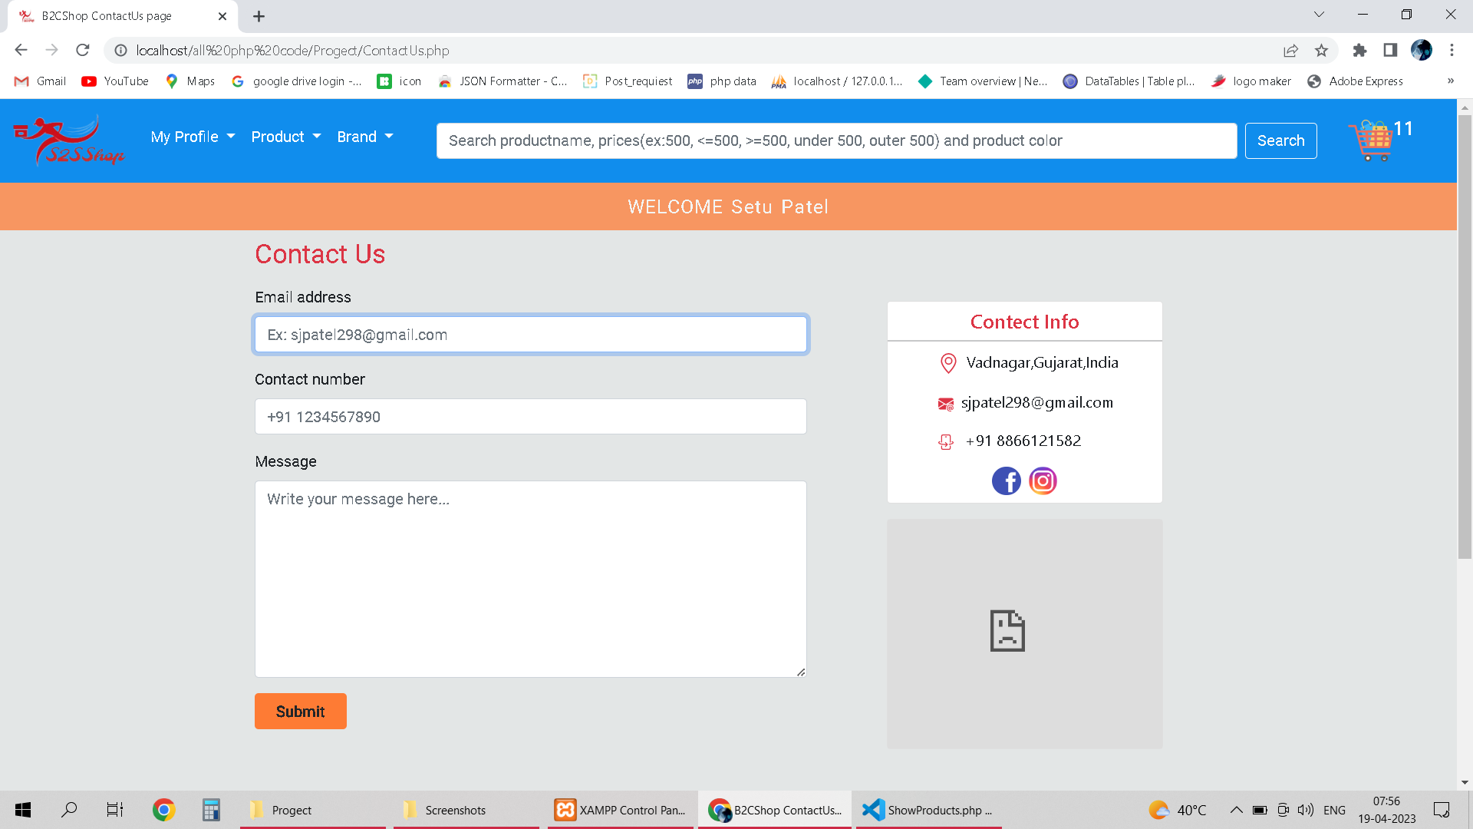
9. Contact us page

Slide 53
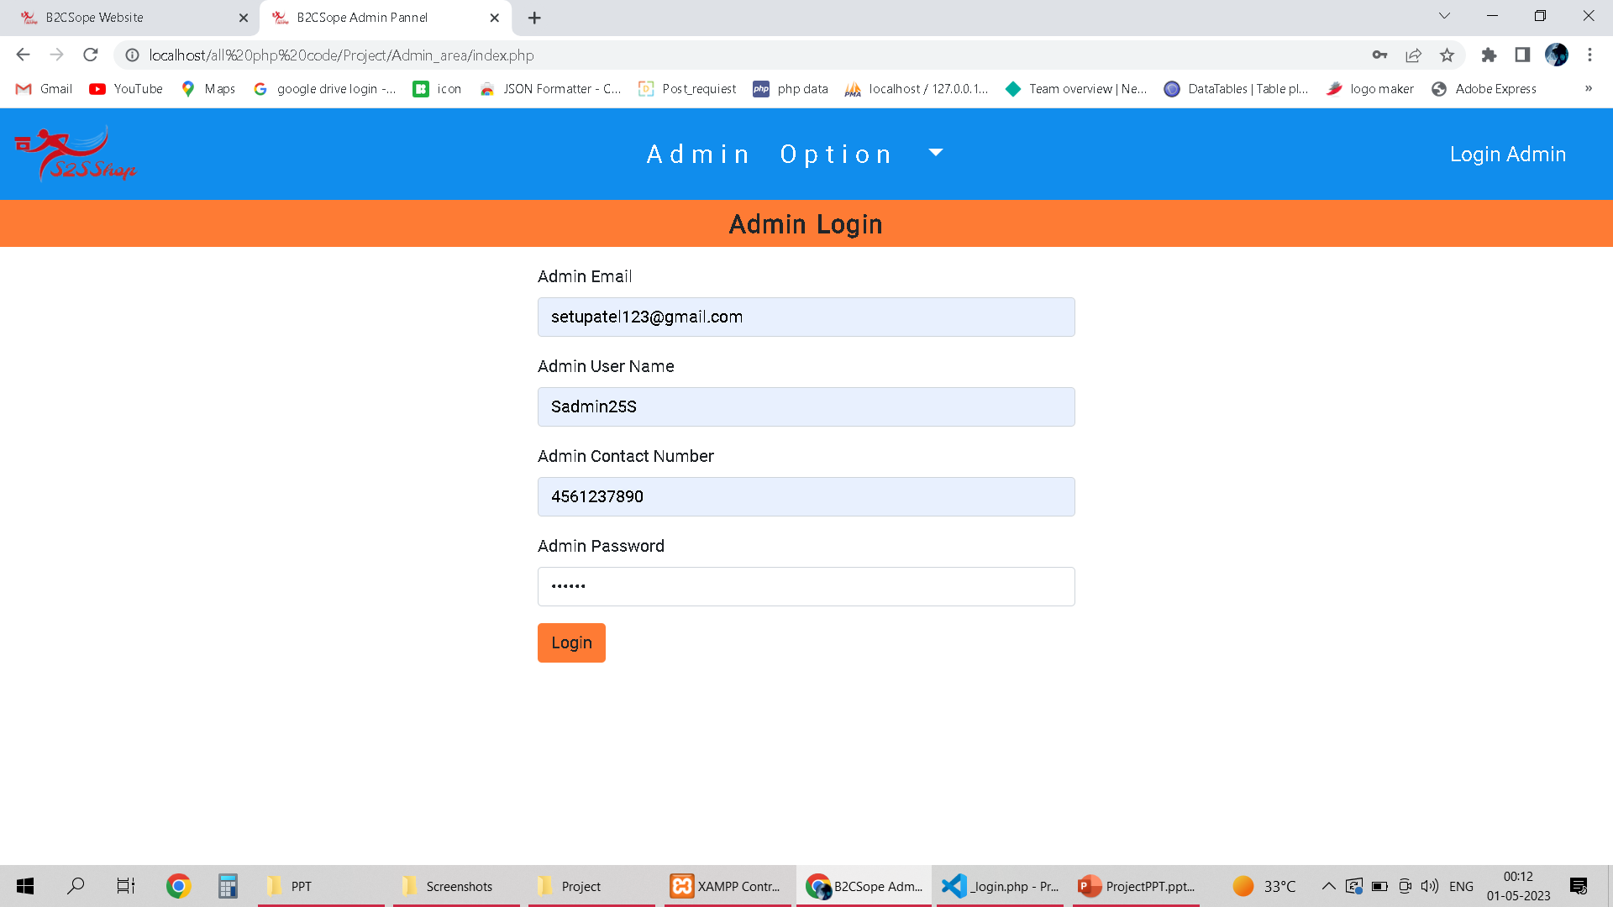
> Admin Side :- 1. Admin Login

Slide 54
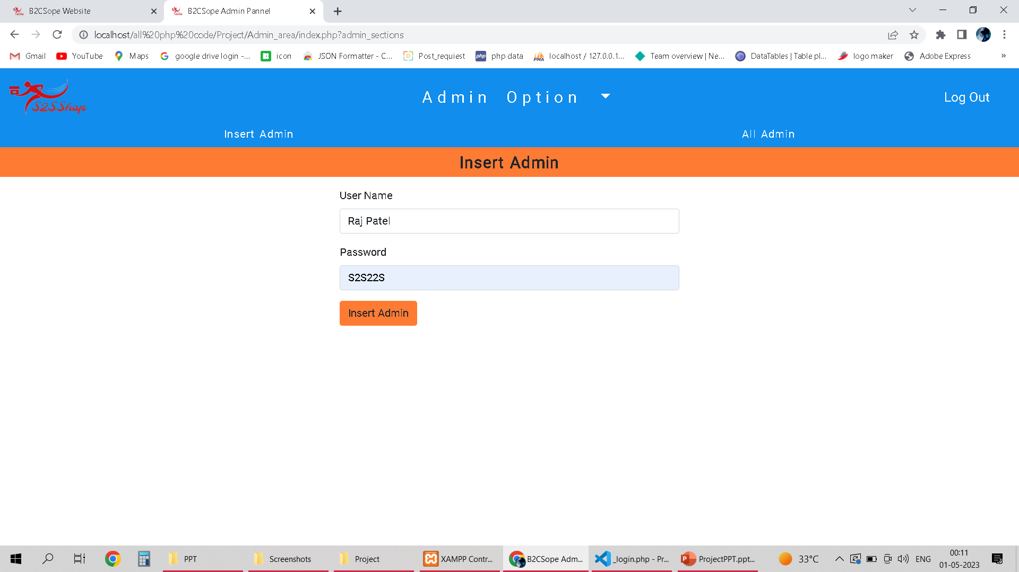
2. Insert New Admin

Slide 55
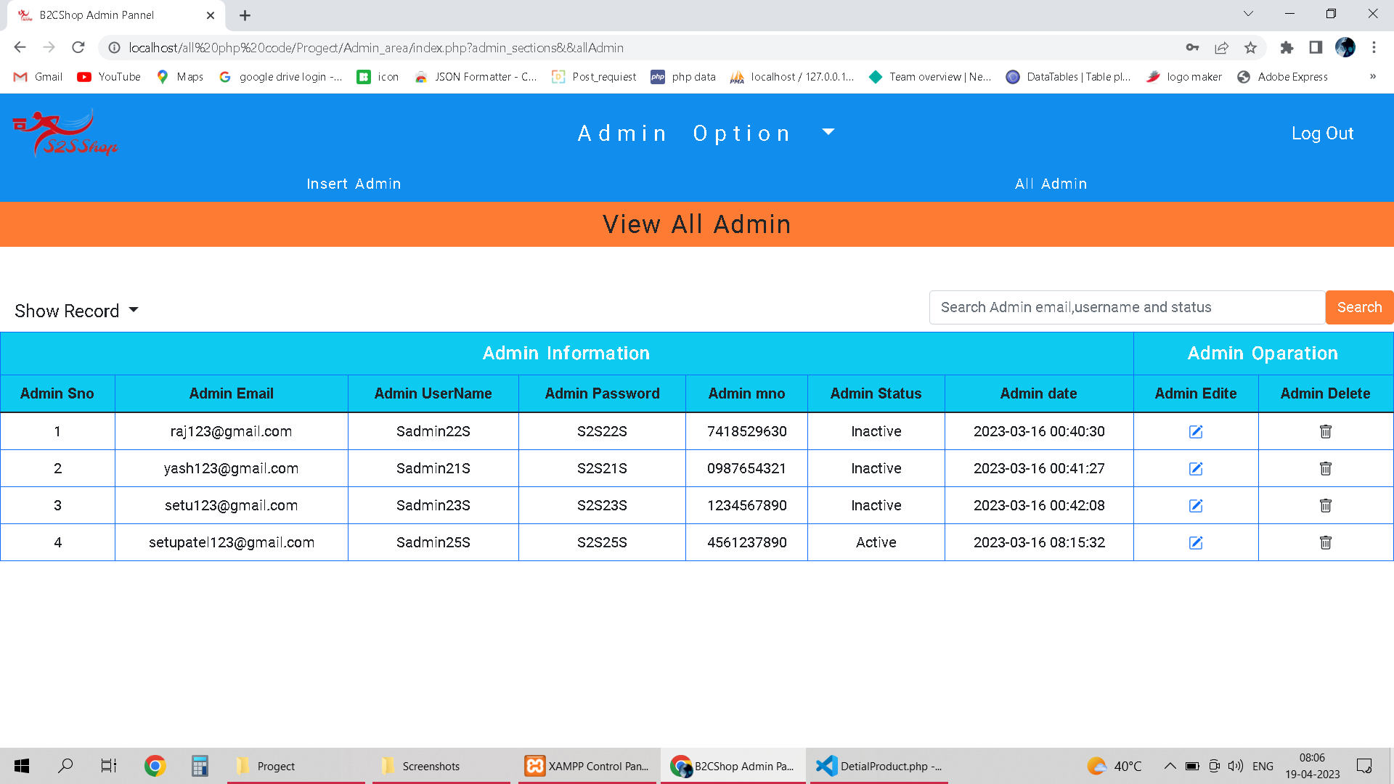
3. View All Admin

Slide 56
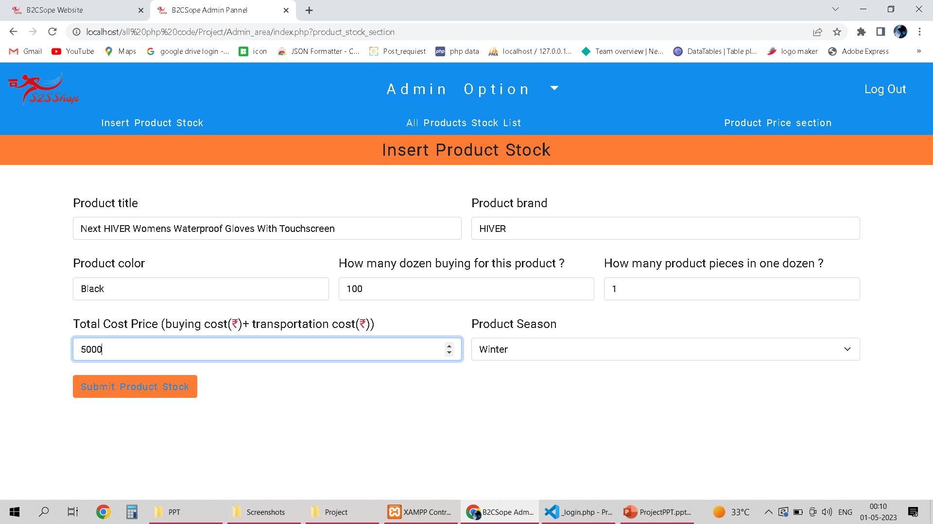
4. Stock Section I Insert Product Stock

Slide 57
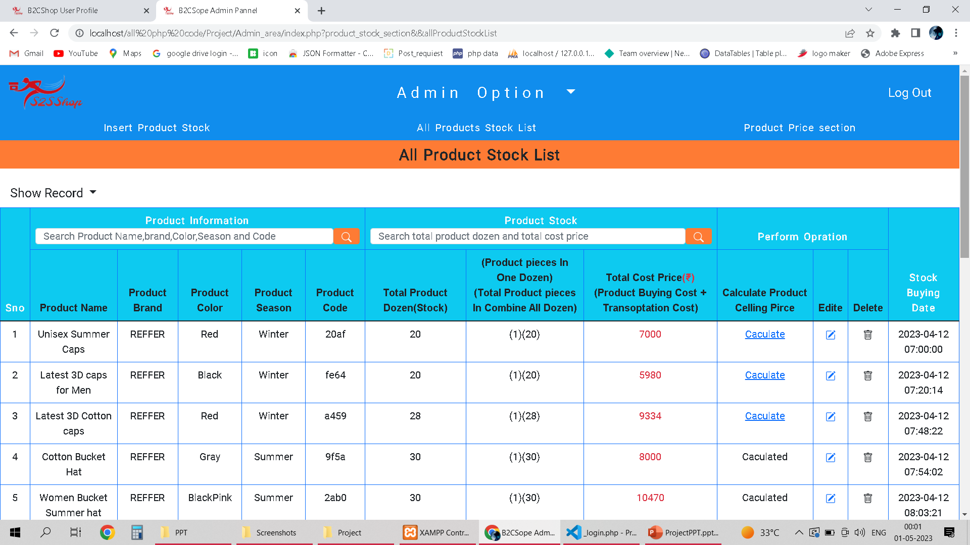
4. Stock Section I All Product Stock List

Slide 58
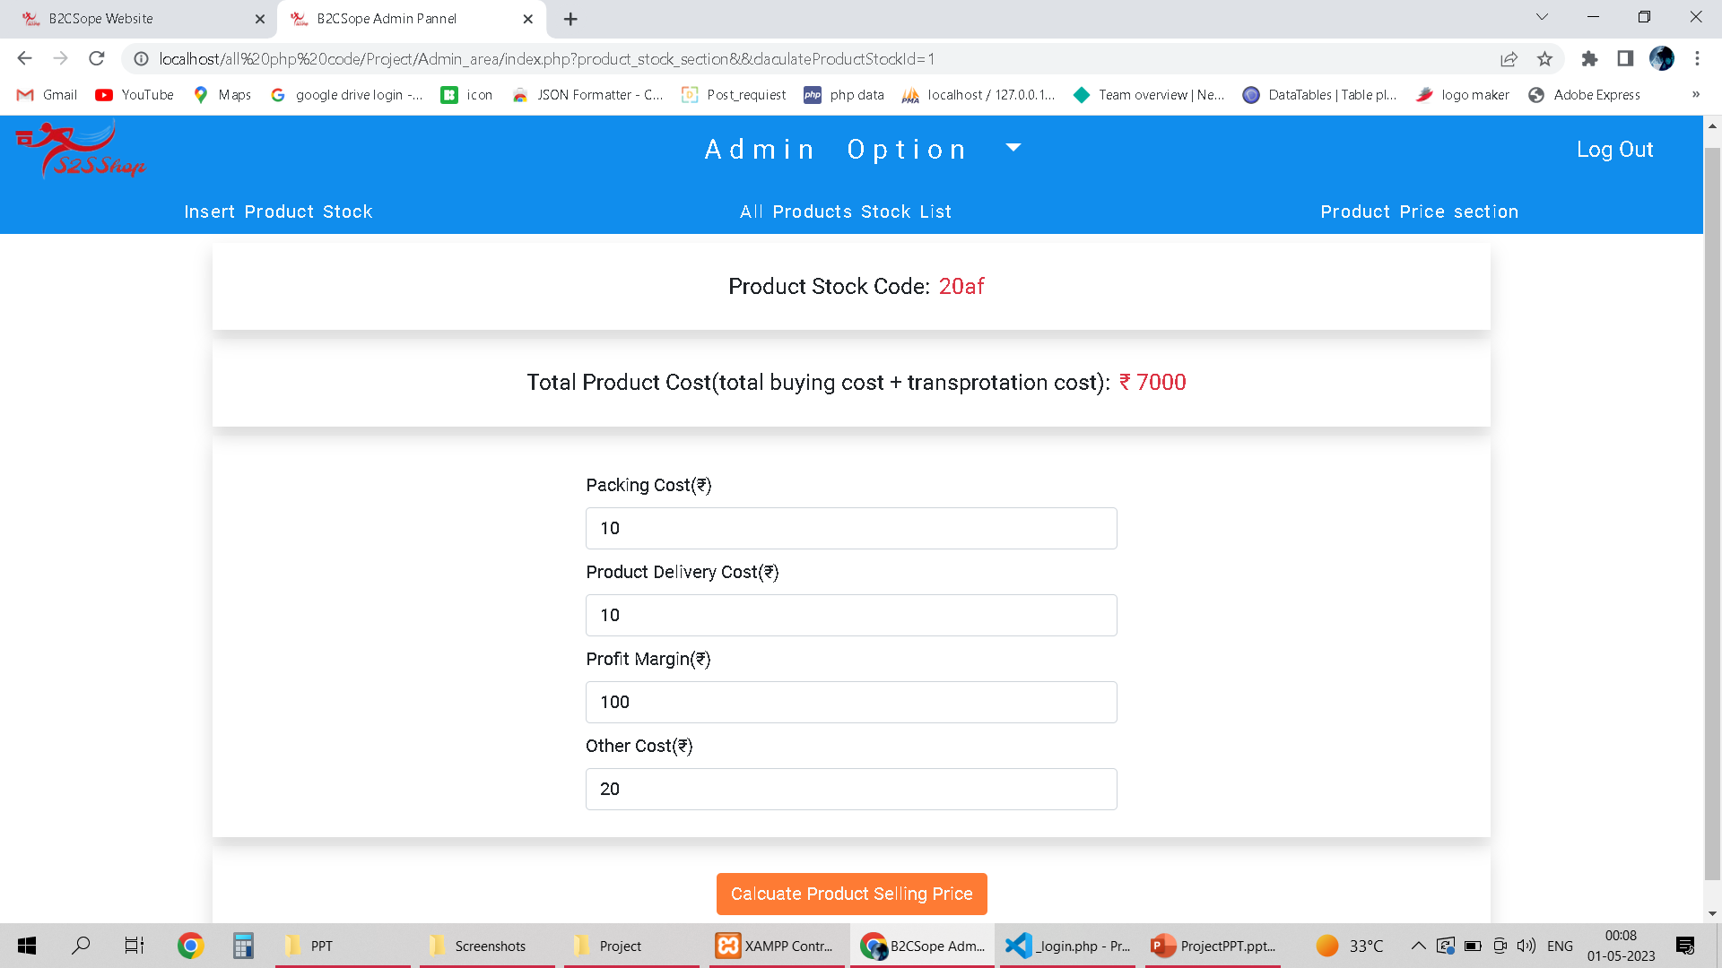
4. Stock Section II. Calculate Product Selling Price

Slide 59
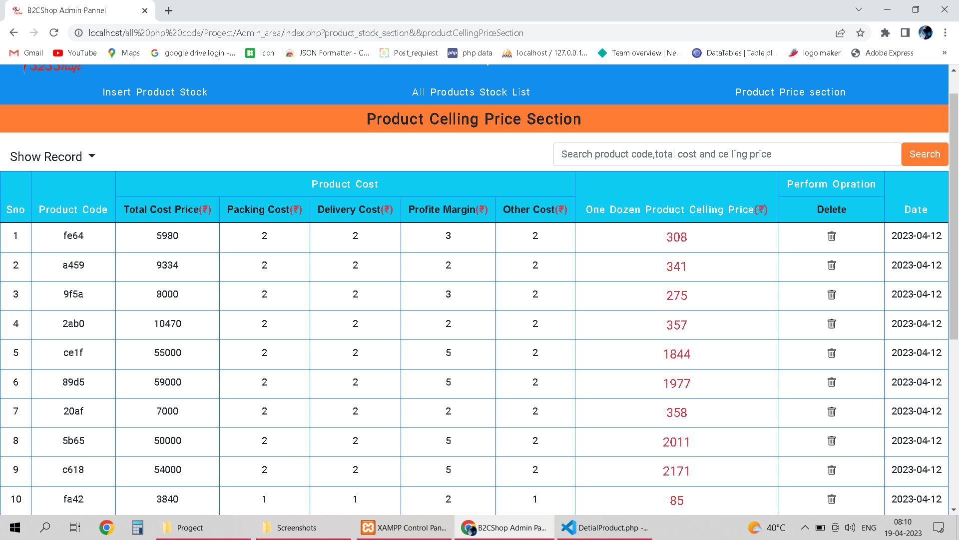
4. Stock Section III. Calculate Product Sealing Price

Slide 60
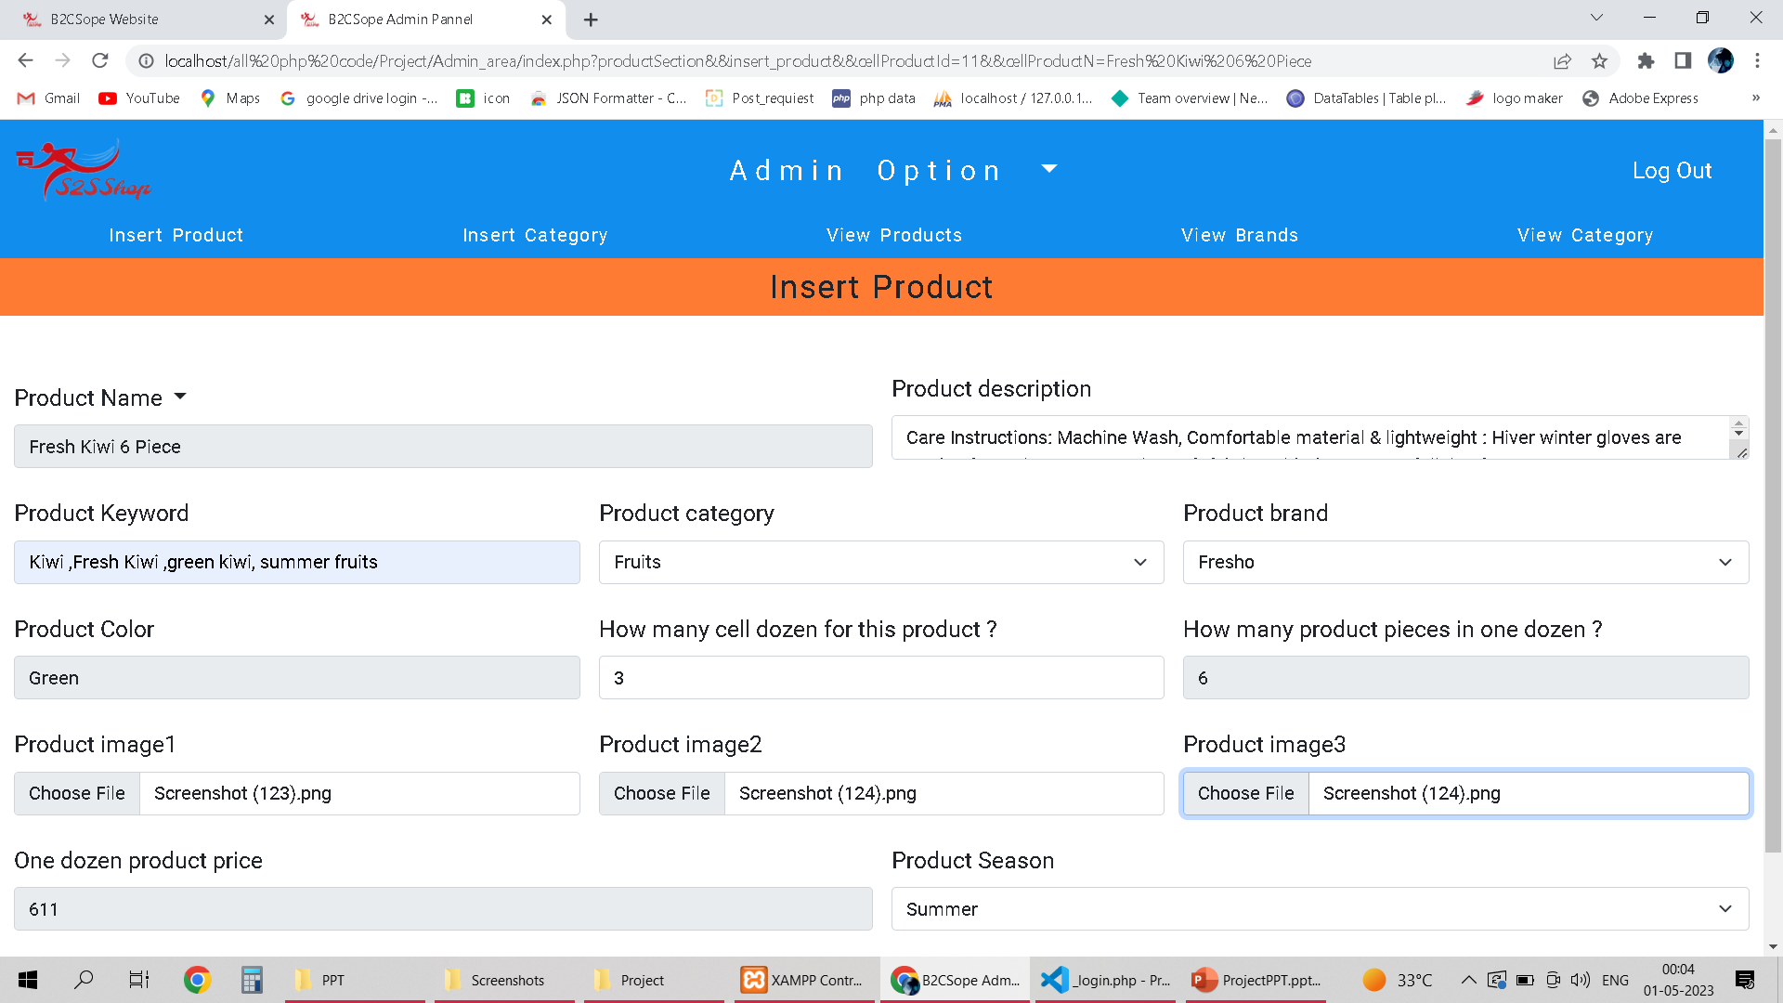
5. Product Section I Insert Product

Slide 61
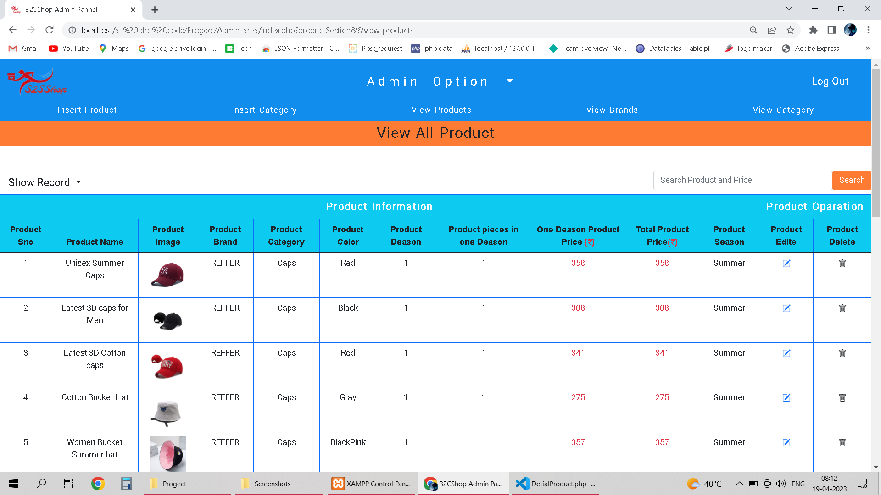
5. Product Section II. View Product

Slide 62
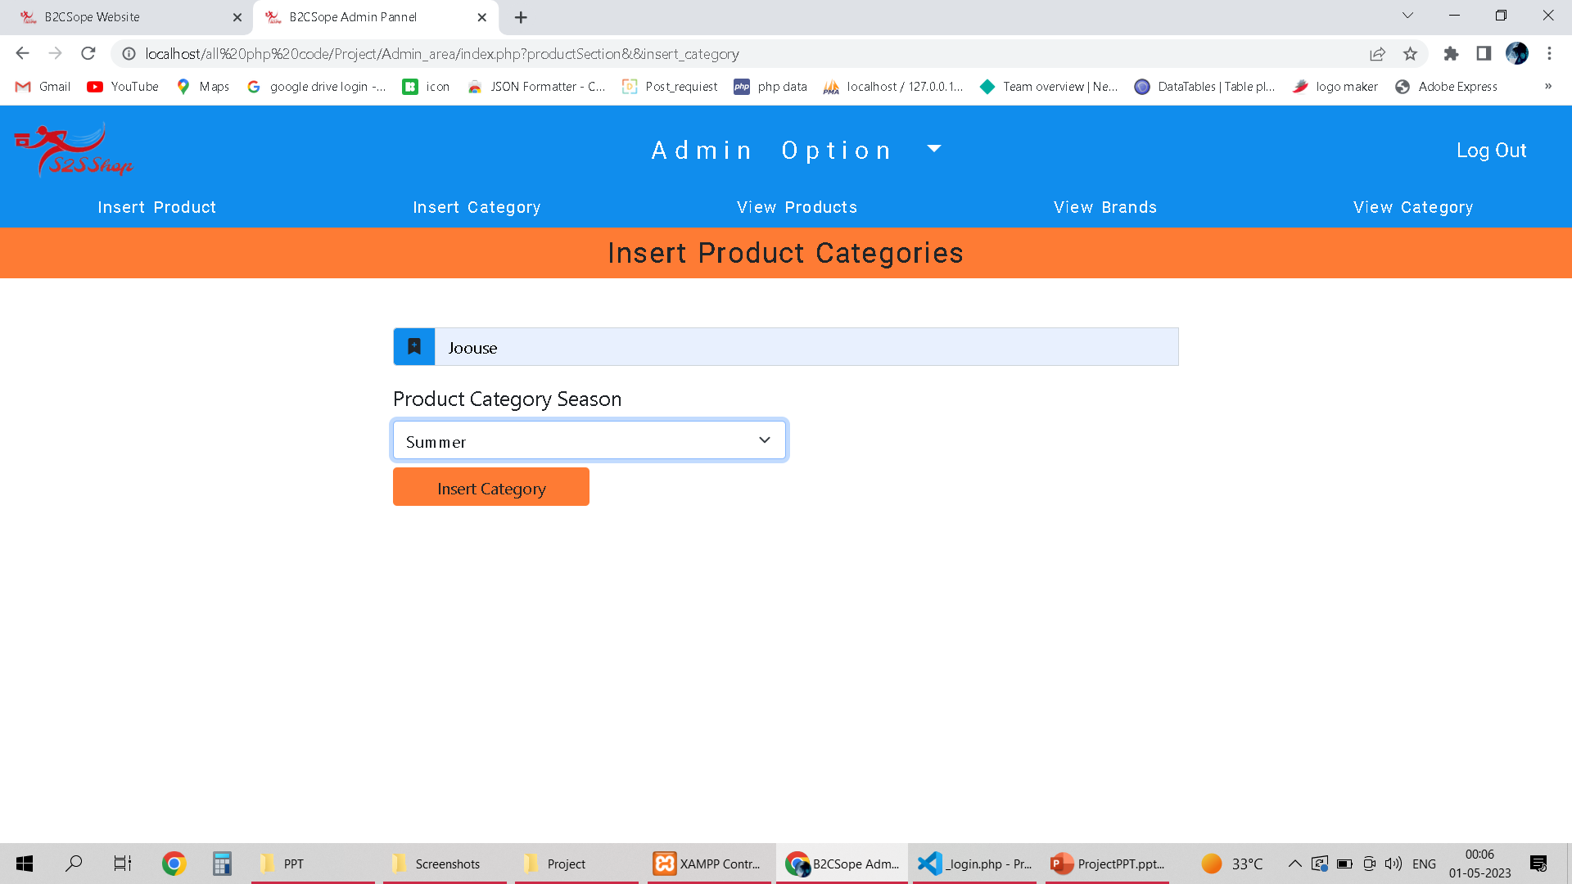
5. Product Section III. Insert Product Category

Slide 63
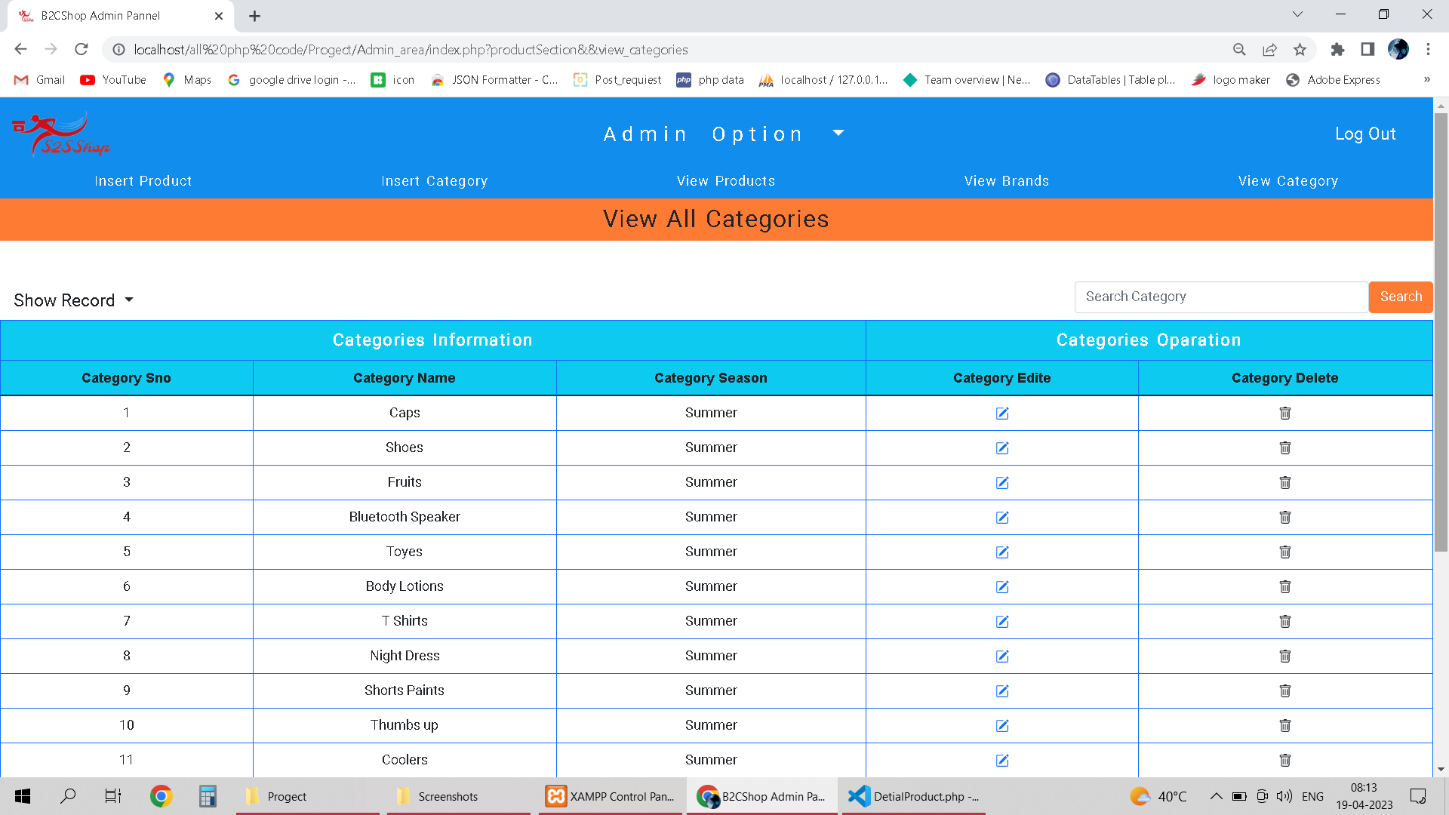
5. Product Section IV. View Categories

Slide 64
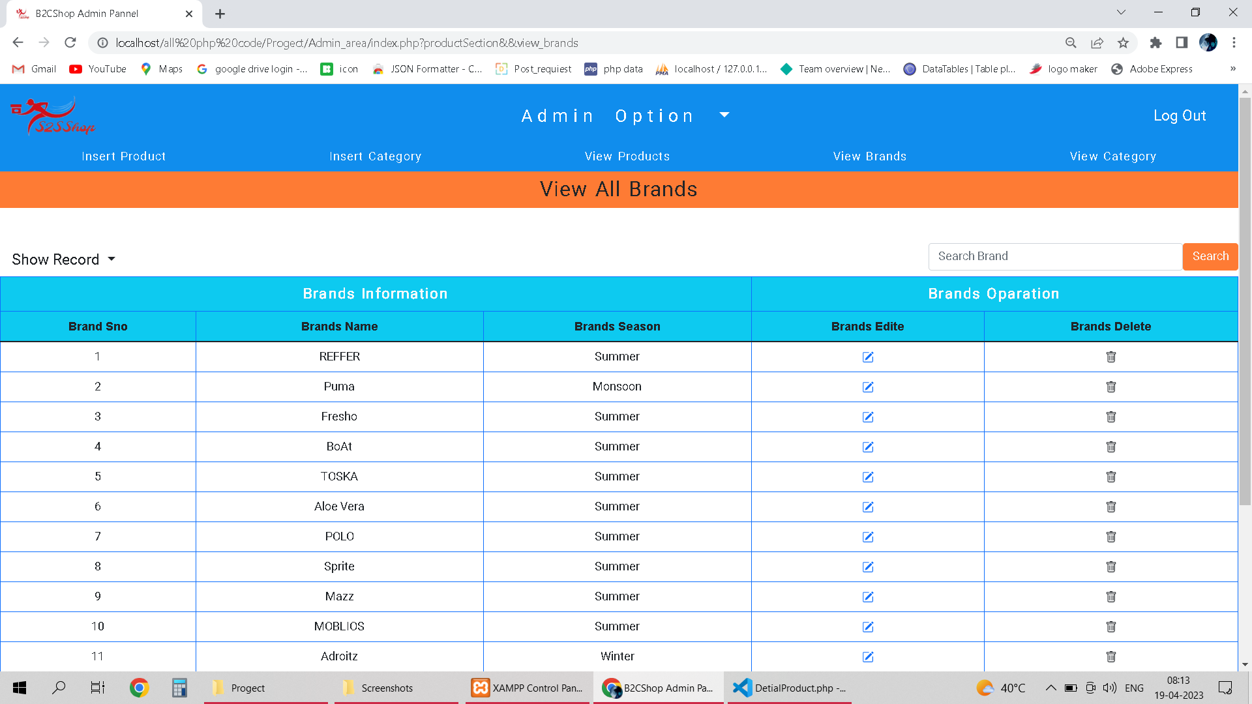
5. Product Section V. View Brands

Slide 65
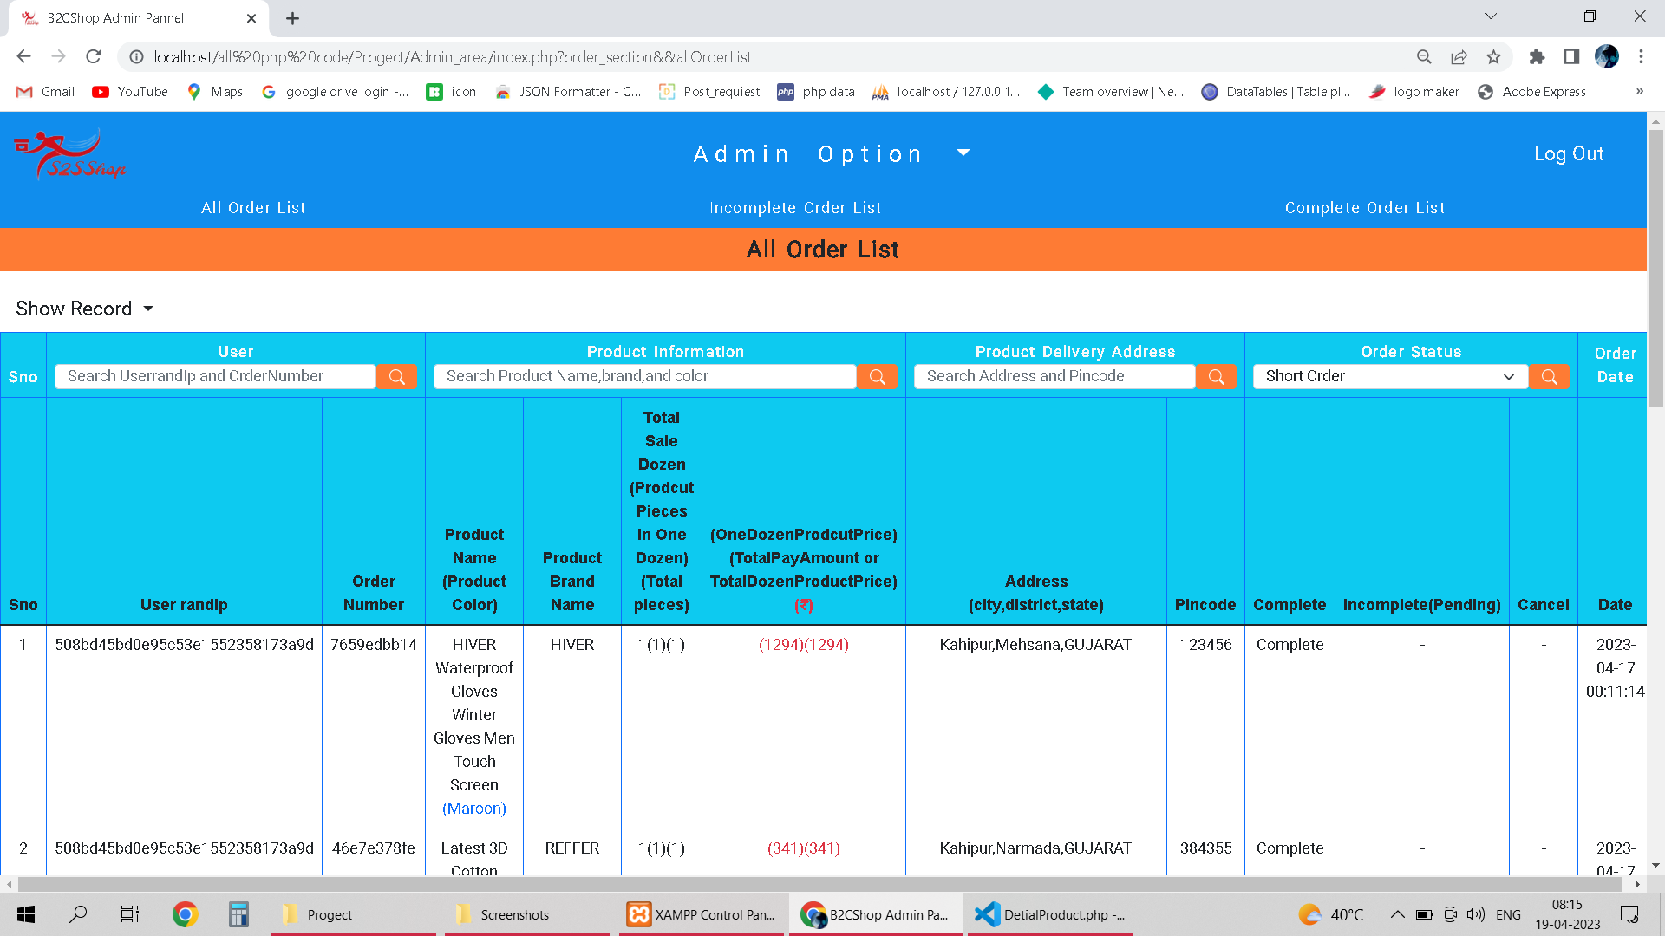
6. Order Section I. All Orders

Slide 66
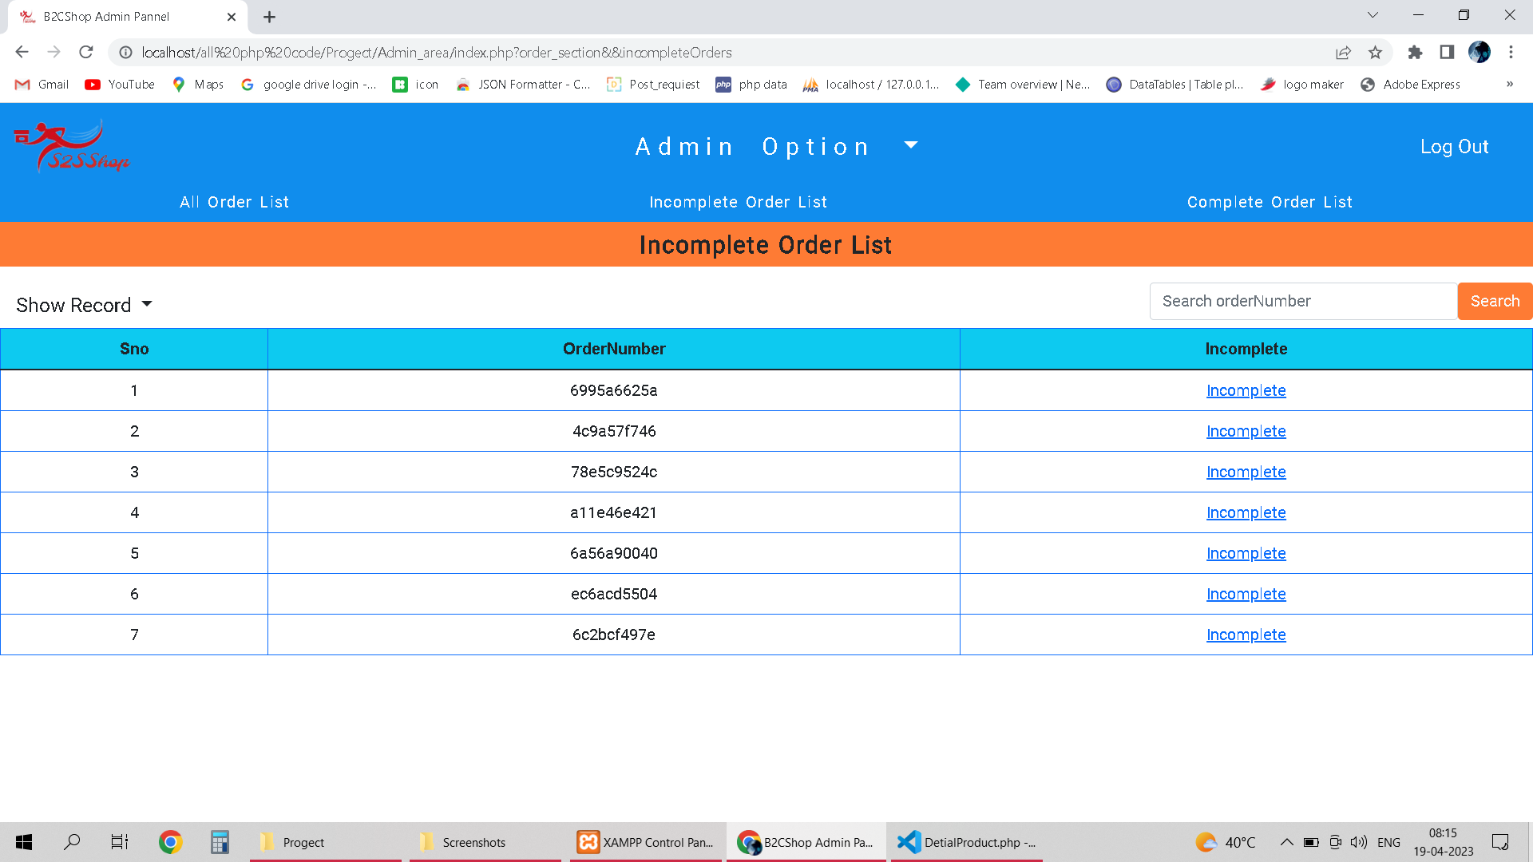
6. Order Section II. Incomplete(Pending) Orders

Slide 67
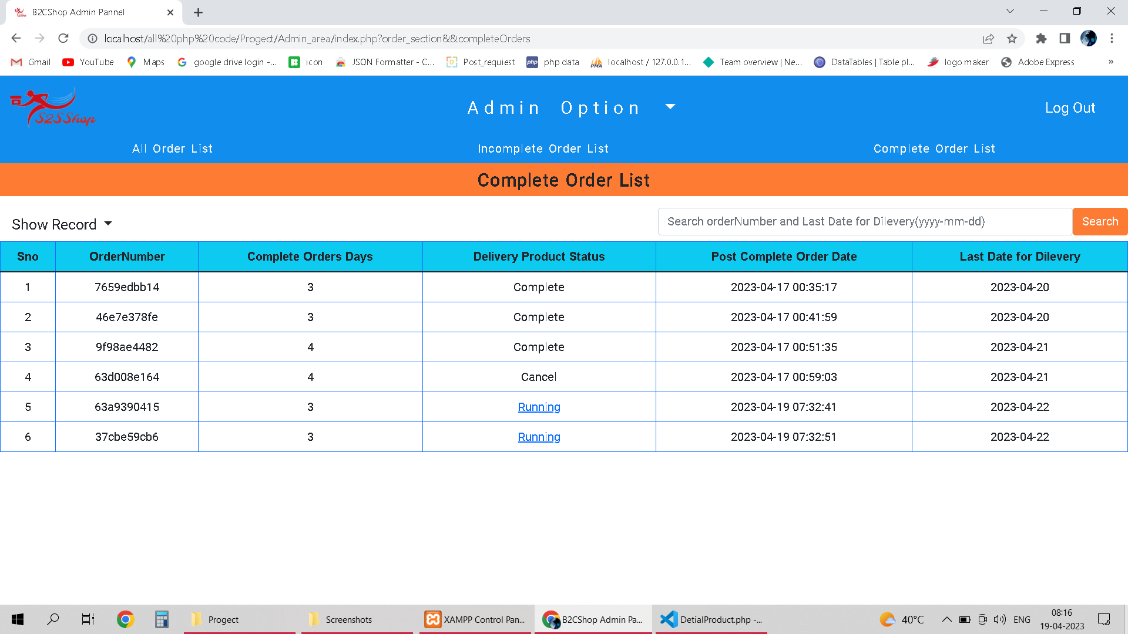
6. Order Section III. Complete Peking, Cancel and Running Orders

Slide 68
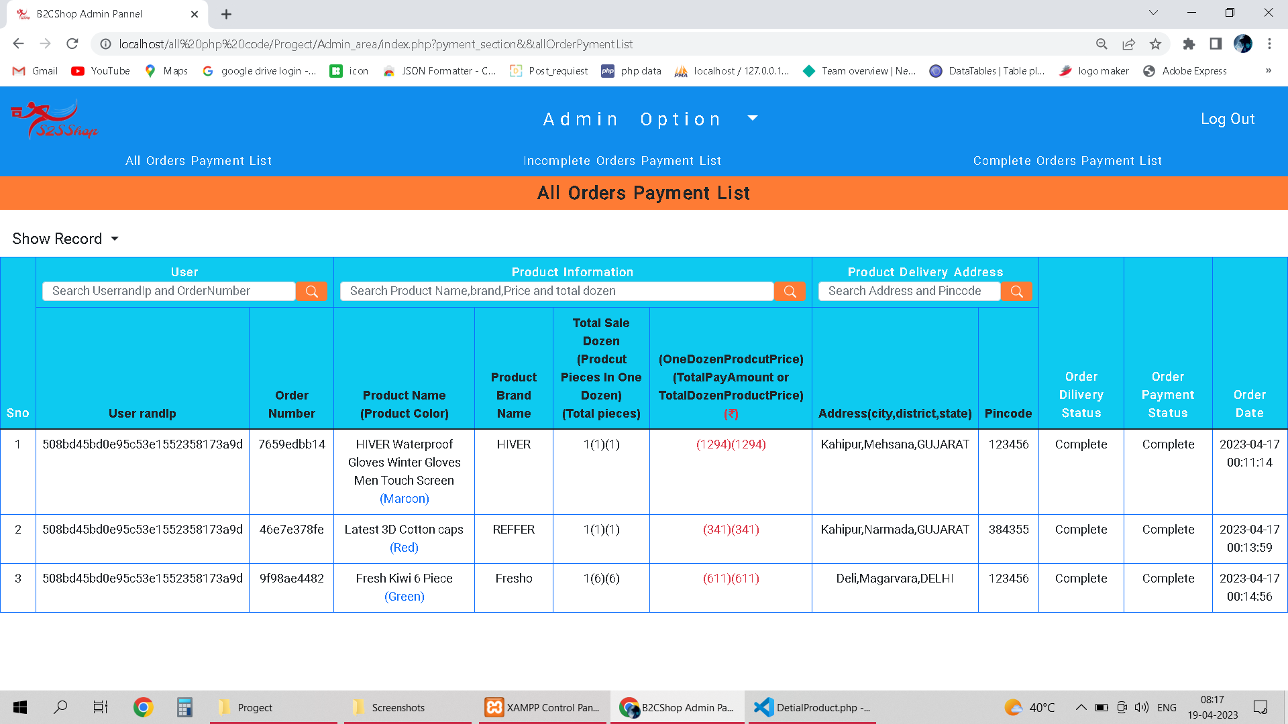
7. Payment Section I. All Orders

Slide 69
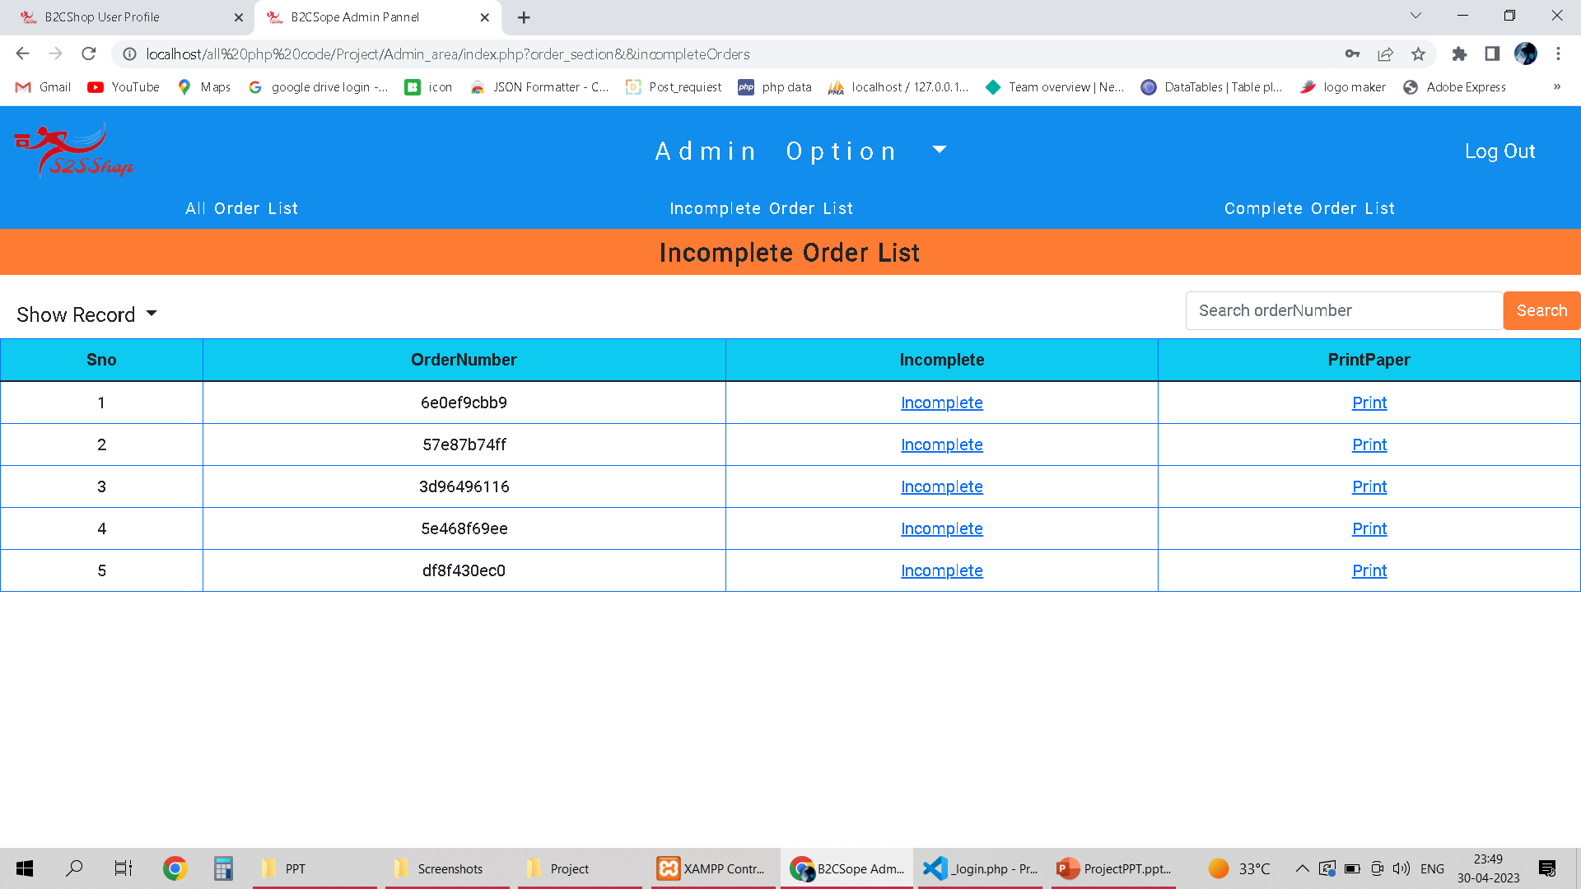
7. Payment Section II. Incomplete Payment Orders

Slide 70
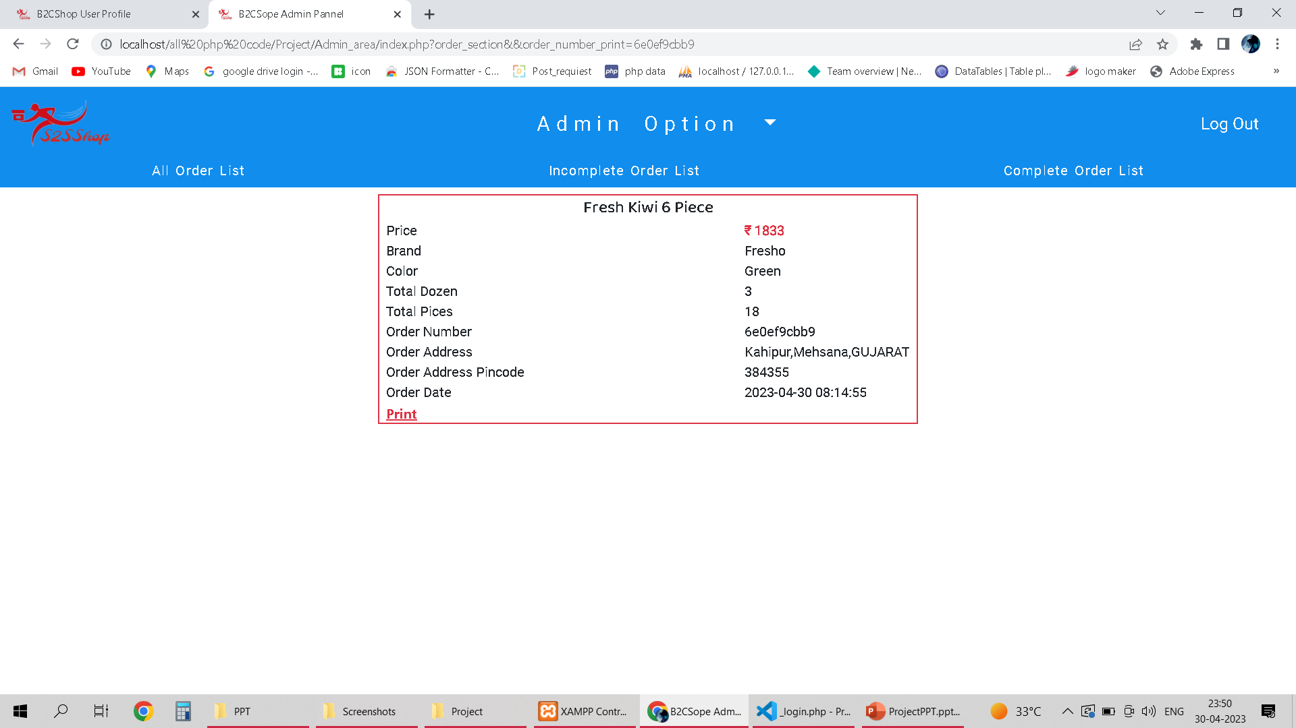
7. Payment Section II. Print Order info

Slide 71
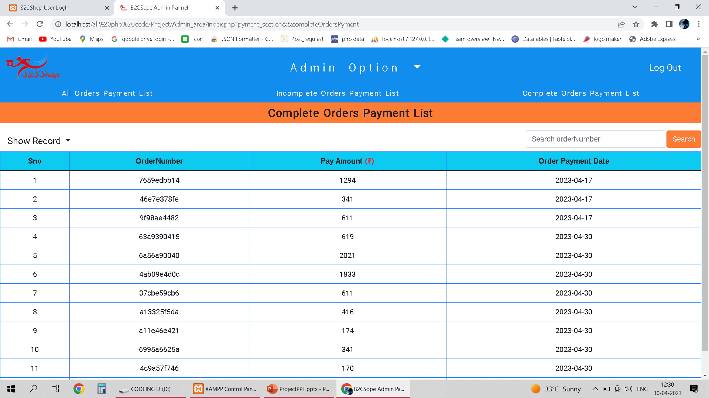
7. Payment Section I. Complete Payments Orders

Slide 72
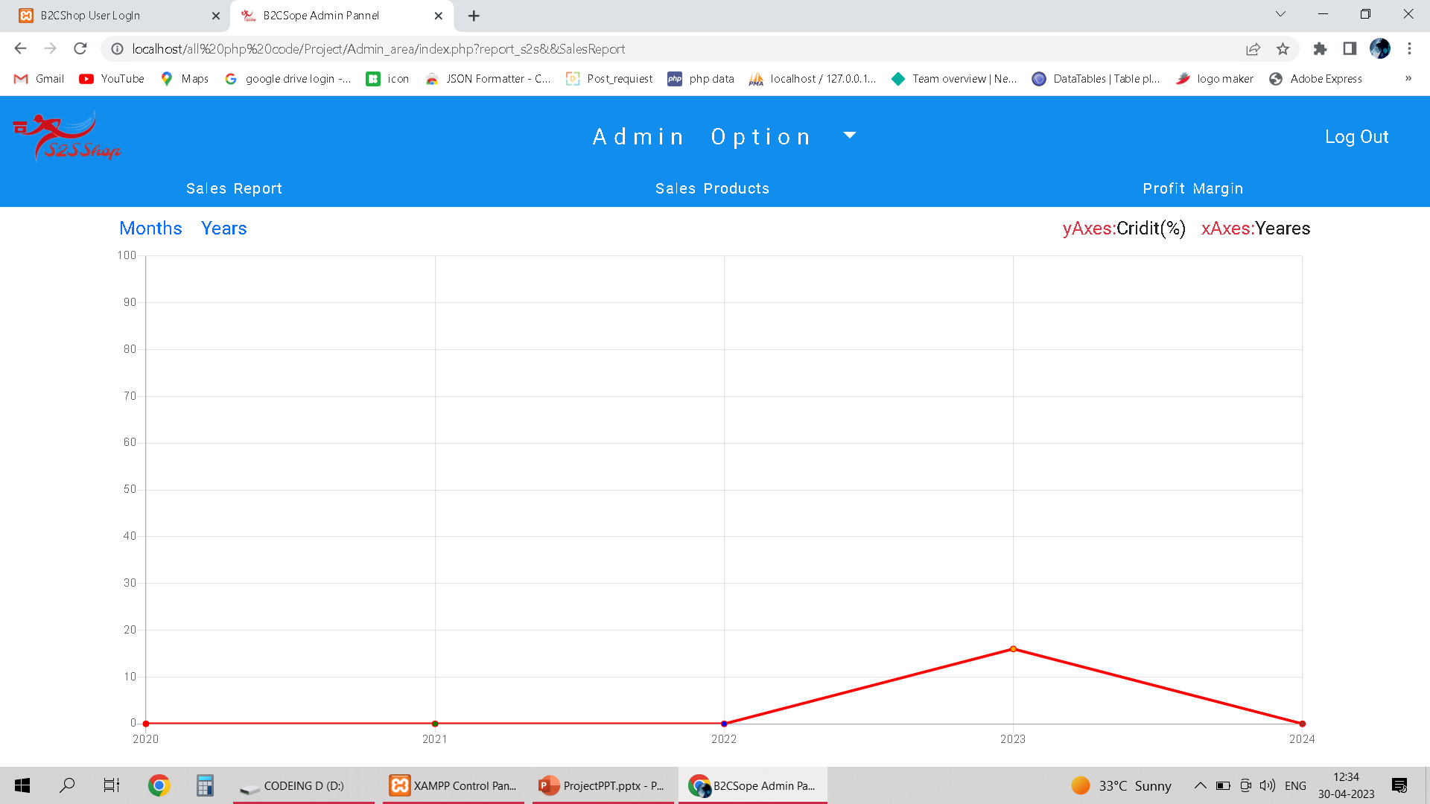
8. Report Section I. Seals (Alltime,Month,Years)

Slide 73
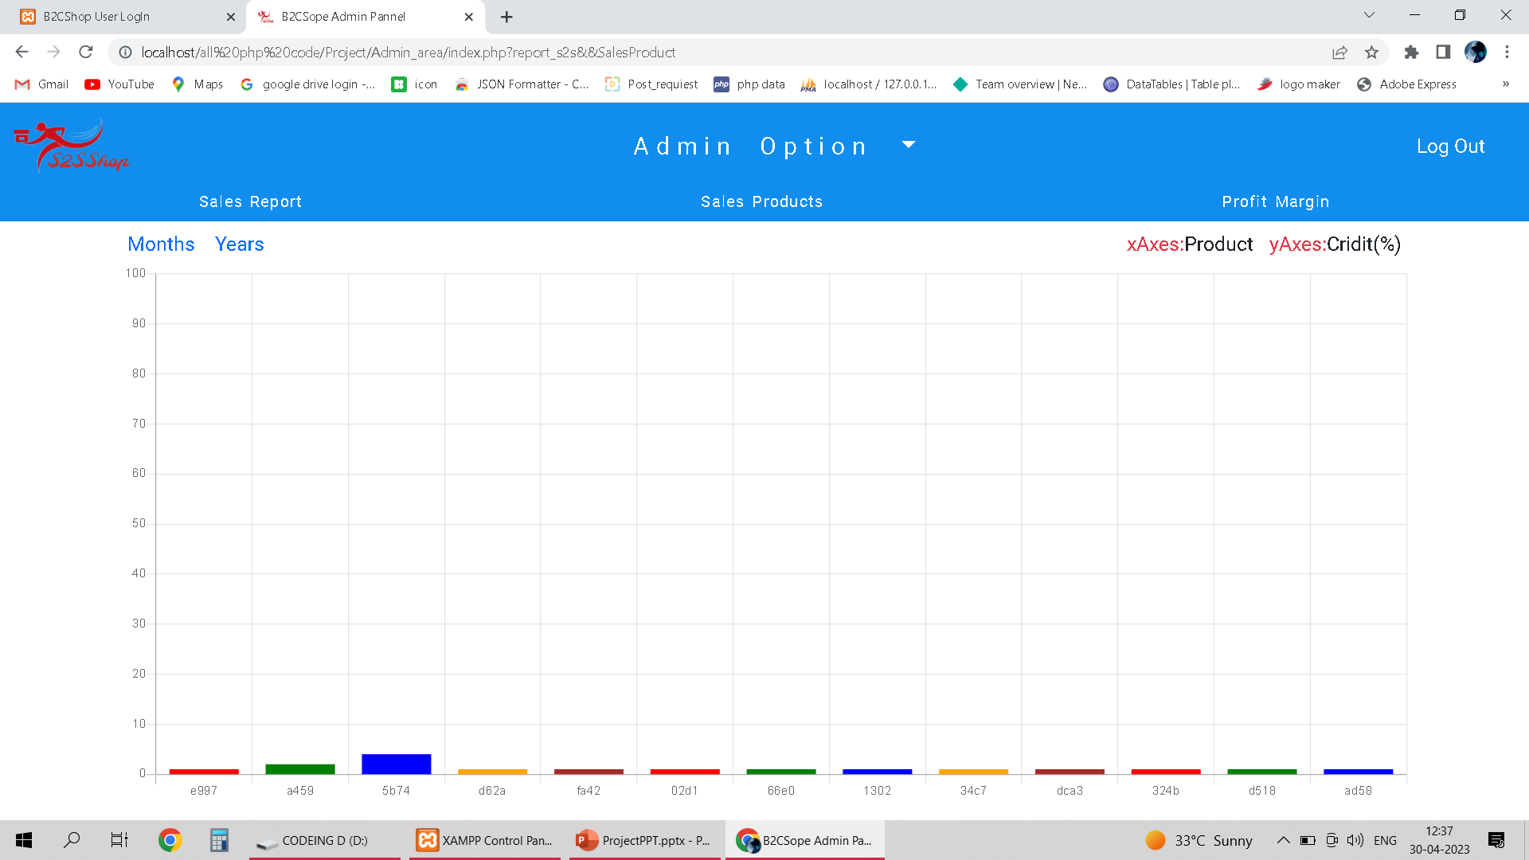
8. Report Section II. Product Seals (Alltime,Month,Years)

Slide 74
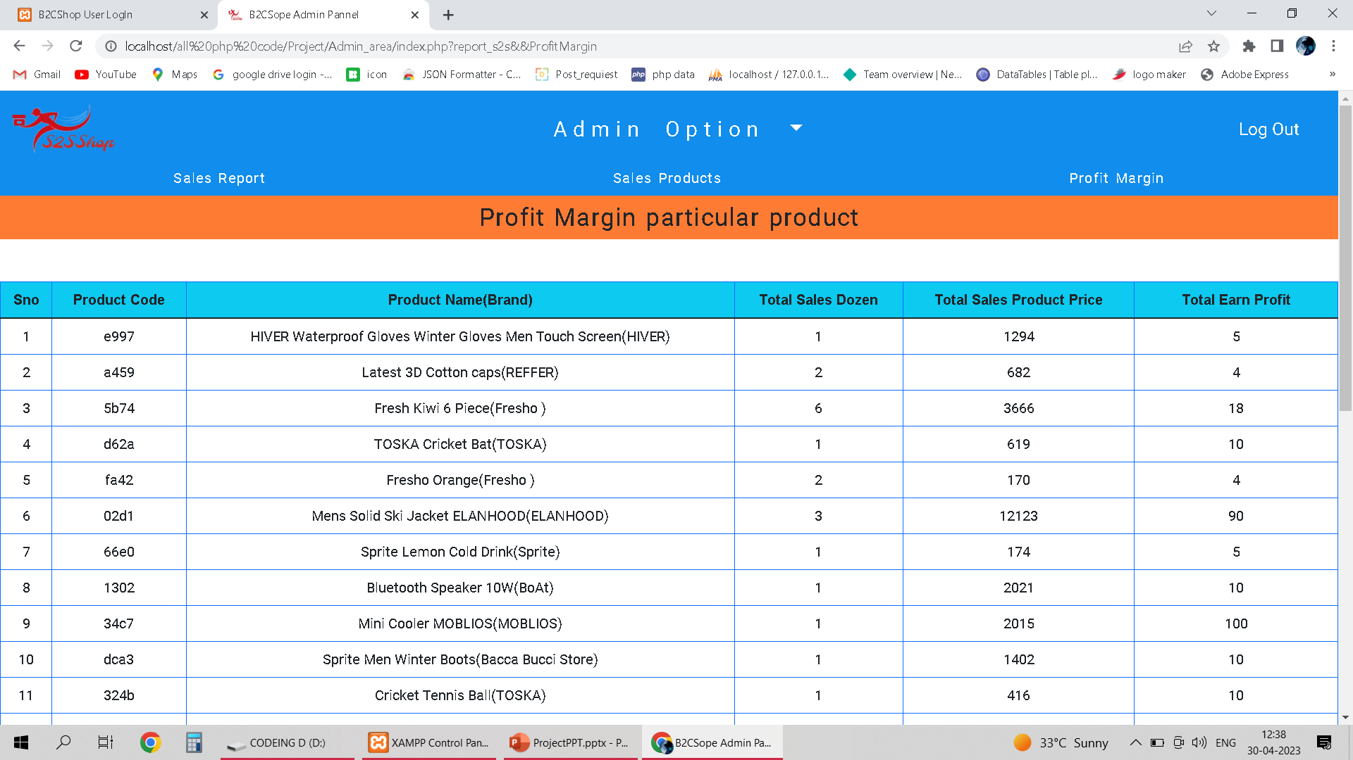
8. Report Section III. Profit Margin

Slide 75
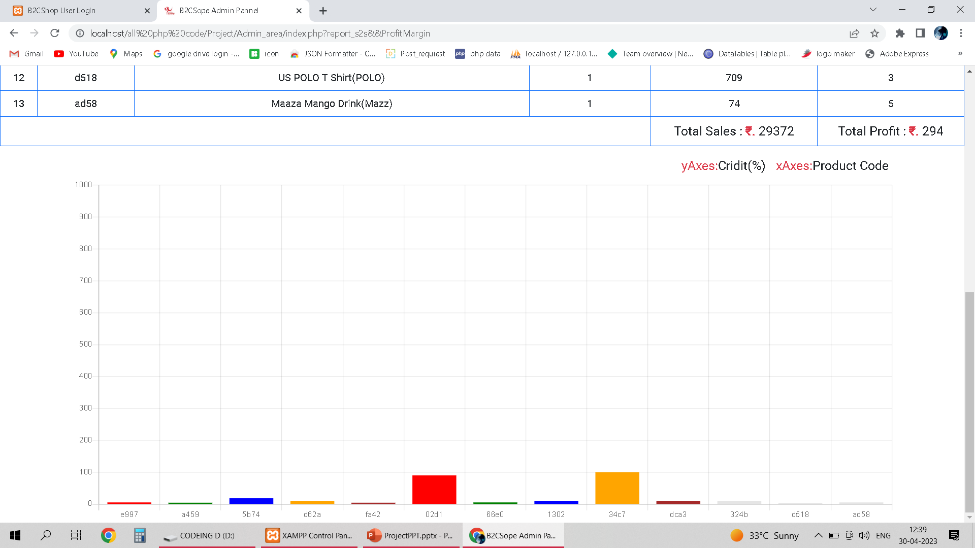

Slide 76
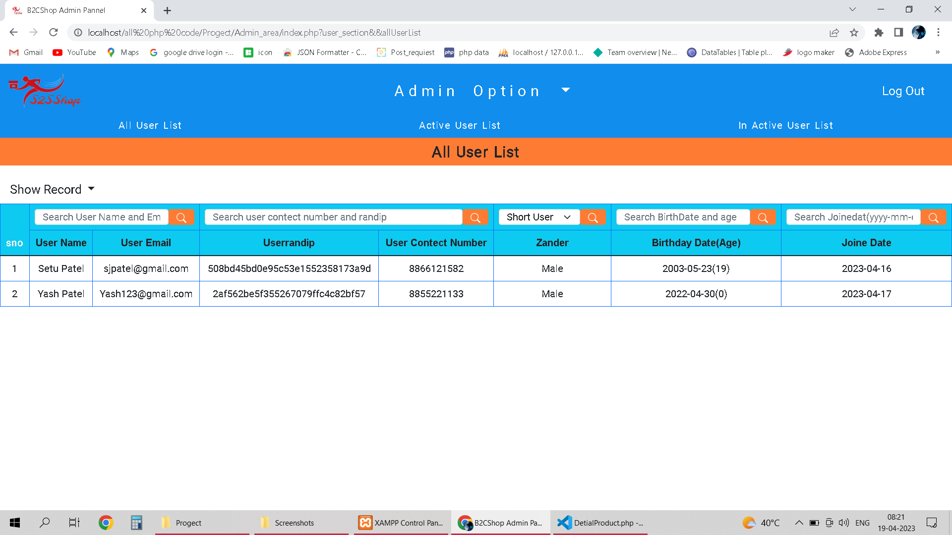

9. User Section I. All User ,Current Active and Not Active

Slide 77

8. User Section

Slide 78

10. Replay Answer

Slide 79
Tank you

